Slide 1
Digitizing RECORDS – ASTR workflow
ASTR DIGITIZATION WORKFLOW
Office of archives, statistics & research
Notes:
Take you through the process that we have formulated to digitize and aptly store records/files.
Important to note that this process may not be perfect, and different organizations may require different processes

Slide 2
process
Prepare
Scan
Store
Verify
ASTR DIGITIZATION WORKFLOW
Notes:
This workflow is a 4 step process
Prepare the documents for digitization
Scanning the documents
Verifying scans
Store the digitized files
I will go through each of these stages and speak to what is involved in each.

Slide 3
Preparation
Box Intake
Data Entry
Cleaning
Generate Cover Sheet
Notes:
One of the most important stages
Prepare documents for scanning
Capture appropriate meta-data
get things right in the initial phase

Slide 4
Box Intake process
Acquisition
Box arrives or acquired from GC Departments with files and documents.
Department/individual delivering new box completes form to indicate contents
Notes:
Box arrives or acquired from GC Departments with files and documents.
Department/individual delivering new box completes form to indicate contents **sample shown on next slide**

Slide 5
Box Intake process
Storage Location Determined
VAULT: Space identified in Vault for storage and location noted for User Box number.
WAREHOUSE: Versatile checked for last Warehouse User Box number used (e.g. WH 4435)
Notes:
Box arrives or acquired from GC Departments with files and documents.
Department/individual delivering new box completes form to indicate contents **sample shown on next slide**

Slide 6
Box Intake process
Box Data Entered & Label Generated
Each file/folder within a box is added to Versatile (Records Management System)
Label is generated for box
Notes:
Box arrives or acquired from GC Departments with files and documents.
Department/individual delivering new box completes form to indicate contents **sample shown on next slide**

Slide 7
box Intake Form
Important Information to Capture:
Originating Department
Media Format
Content
Year Range (e.g. Span 1974-1978)
Future plans include moving to an online form.
Notes:
Important Information to Capture:
Originating Department
Media Format (3 ½ Floppy disks, CD, Hard Drive, etc.)
Content
Year Range (e.g. Span 1974-1978)
INTAKE FORM is important as you do not want to assume

Slide 8
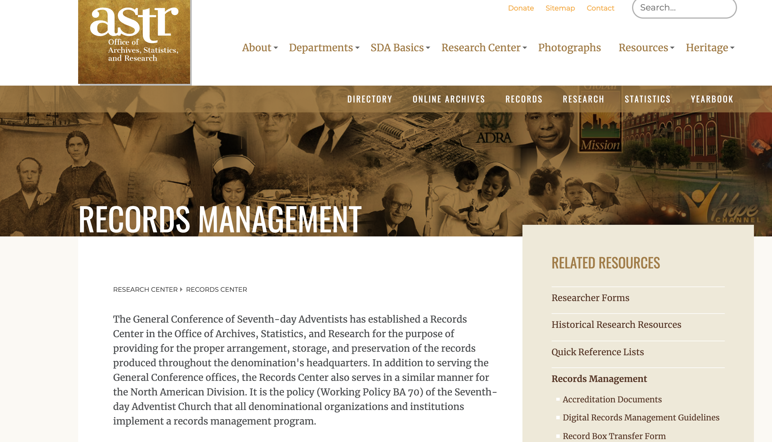

Slide 9
Data entry
Each file/folder within a box is entered in the Records Management System (Versatile) as a new record.
Coversheets are generated from Versatile for each file/folder to be scanned
Notes:
Each file/folder within a box is added to Versatile as a new record, and assigned to the box created in the previous step.
Coversheets are generated from Versatile for each file/folder to be scanned

Slide 10
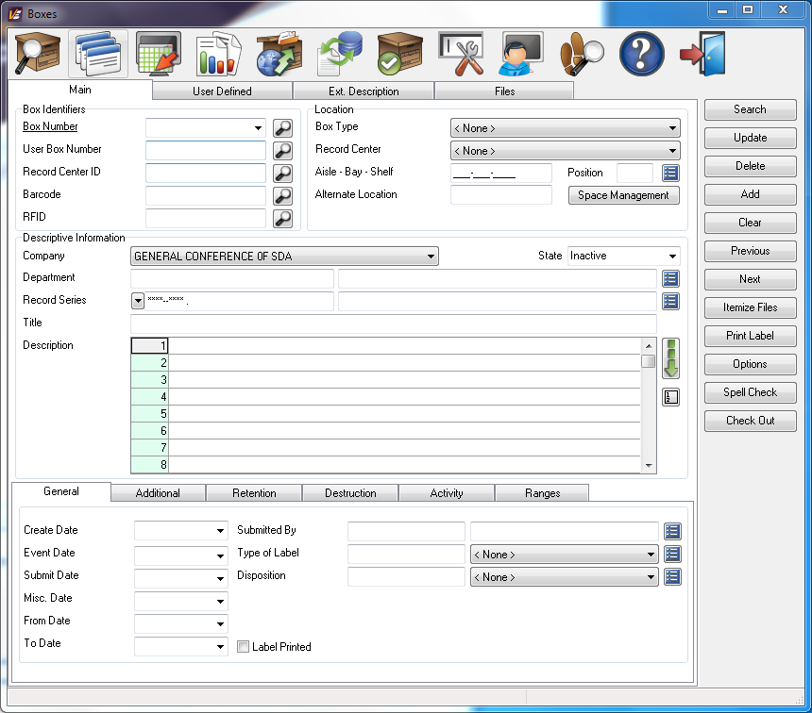
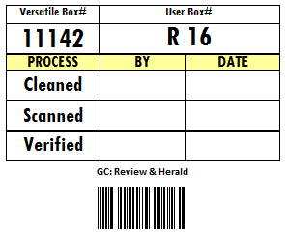
New Box entry
Box Number (Automatically Generated)
User Box Number
Department
Record Series
Title
Description
Location
Label Type
Disposition
Dates
Sample Box Label
Notes:
Box is created in Versatile using the data provided on the form and user box number determined in the previous step.
User Box number is determined by storage location
Label is generated for box with relevant data including Versatile Box Number and User Box Number (printed from Versatile).
Disposition examples: Scan to Digital, Toss, Shred
Record Series

Slide 11
file/folder entry
Record Number (Automatically Generated)
Department
Title
Description
Record Series
Dates (Event, Creation, etc.)
Media Type
Notes:
Record series are units of files or documents arranged according to a filing system or kept together because they: Relate to a particular subject or function. Result from the same activity. Document a specific kind of transaction.

Slide 12
Sample Cover Sheet
Project Name
Department Name
Description of Content
Record #
Record Series
QR Code
Notes:
Importance of Bar Code & QR Code
- Project Name and Department Name helps to organize scans

Slide 13
Cleaning
DOCUMENT PREPARATION PROCESS
Bindings removed and files are prepared for scanning
Discard Metal Objects
Paper Clips, Staples, Pins, etc.
Handle Atypical Paper
Reposition nonstandard sized paper within the stack to facilitate feeding into scanner
Expose All Content
Separate content that may obscure useful information on the page it is attached to (e.g. large photographs taped to an application)
Insert Coversheets
Insert coversheet at beginning of document (Folder)
Notes:
Bindings removed and files are prepared for scanning

Slide 14
scanning
Files are scanned in Kodak Capture software with coversheet placed at the beginning of each file.
Scan Document
Ensure all pages are scanned
Verify Scan
Delete blank pages, rescan misfeeds, rotate pages (if necessary)
Process Scan
Generate PDF and TIFF formats, and move to appropriate destination (automated by scanning software)
Fix Process Errors
If necessary, correct index errors, remedy network connections, delete previously existing files
Verify Box
Verify all documents within the active box have successfully processed
Notes:
Files are scanned in Kodak Capture software with coversheet placed at the beginning of each file.

Slide 15
scanning – Industry Standards
Business Documents: | 300dpi
Archival Images: | 600dpi
DPI = Dots Per Inch

Slide 16
scanning – Guidelines for DIGITIZING Archival Photos
Archival Photos should be scanned at 600dpi in TIFF. If necessary, a JPG scan should be generated to facilitate online publishing.
The scan should be straight and have an even strip of space around the edges of the photo. We are scanning the object instead of merely the picture.
Relevant metadata should be added as available.

Slide 17
Scanning – File Types
Processing creates 2 types of files for each document
Widely Supported
No Compression
Stores a Collection of Images
Text Recognition
Smaller File Size
Notes:
TIFF – widely supported format
Flexible file format that handles images and data in a single file
No Compression – image is in original high quality
PDFs for text recognition capabilities and facilitates easy transfer due to the file size.
XML – Data about the document, used to facilitate the verification process.
TEXT – metadata about the document

Slide 18
Scanning – USEFUL TOOLS
Kodak Alaris Capture Pro Software
Automatic Image Rotation
Detect and Remove Blank Pages
Organize Scanning Jobs
OCR Capability
System Integration
Notes:
Files are scanned in Kodak Capture software with coversheet placed at the beginning of each file.

Slide 19
scanning – Equipment
Production Scanners are classified typically by their capacity and scanning speed.
 | Low Volume | Medium Volume | High Volume
Pages per minute | 20-35 | 40-60 | 70-130
Page feeder capacity | 50 | 50-60 | 500
Expected daily volume | 400-2000 | 2000-4000 | 20,000-60,000

Slide 20
verification
Documents are verified against scans to ensure that all information was accurately captured.
Verify Box
All Documents (Folders) within a Box have successfully been processed
Verify Metadata
Metadata is consistent between Records Management Software, Coversheets, Filenames, and SharePoint (if used)
Verify PDFs
PDF files are in the proper destination(s)
Verify TIFFs
TIFF files are in the proper destination(s)
Verify Complete Project
Once project is complete, verify that all documents, boxes, PDFs and TIFs are accounted for and appropriately located.
Notes:
Documents are verified against scans to ensure that all information was accurately captured.

Slide 21
store
Secure Network Storage
Offsite Backup
Laserfiche
Notes:
Files are then processed and transferred to a:
Secure Network Storage
SharePoint Collection
Laserfiche Repository
Off Site Backup

Slide 22
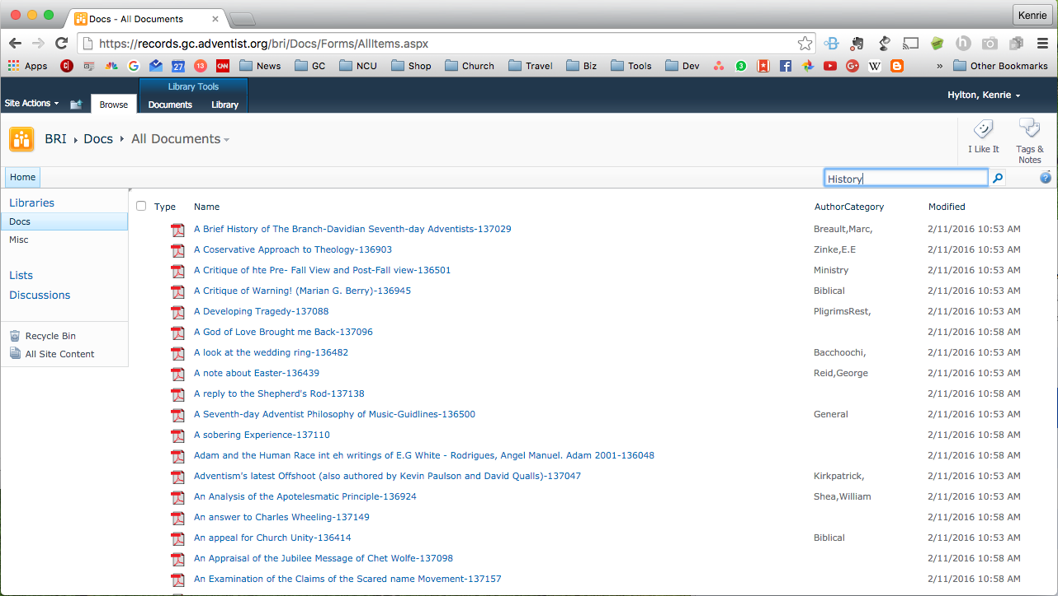
Search
Sort & Filter
Notes:
OCR – Optical Character Recognition is run on all PDF documents, therefore a search can be done not only for the title but for text in the content itself.

Slide 23
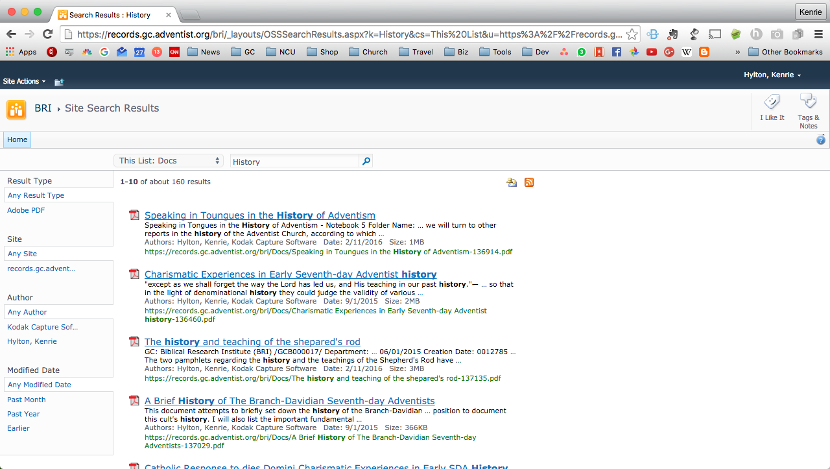

Slide 24
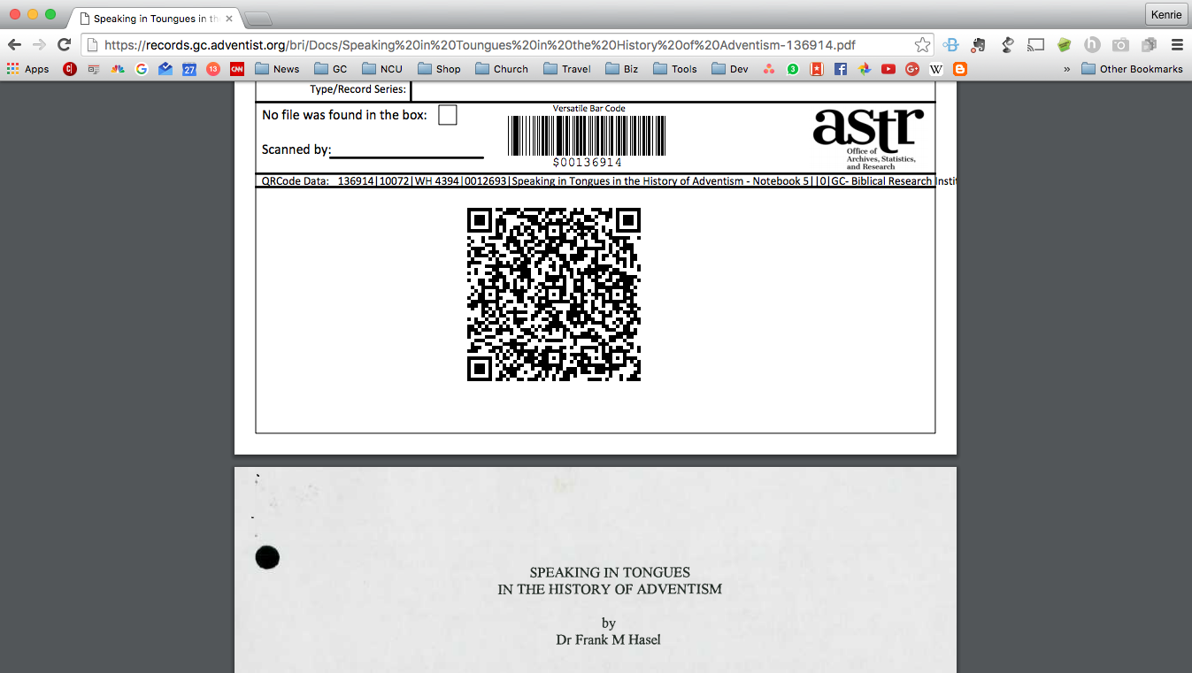

Slide 25
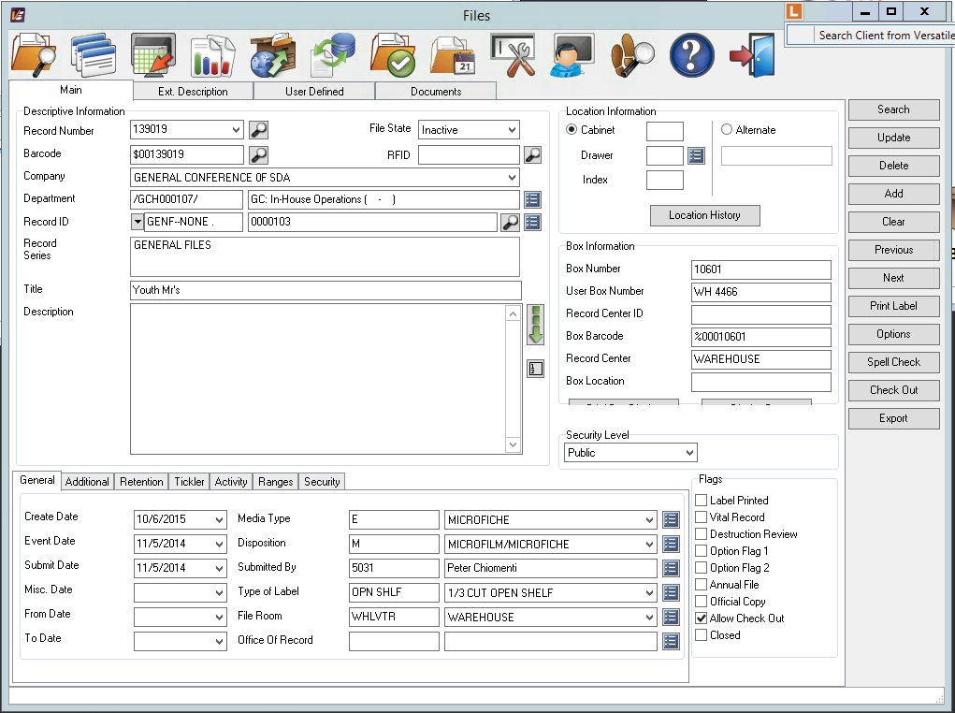
Laserfiche Integration

Slide 26
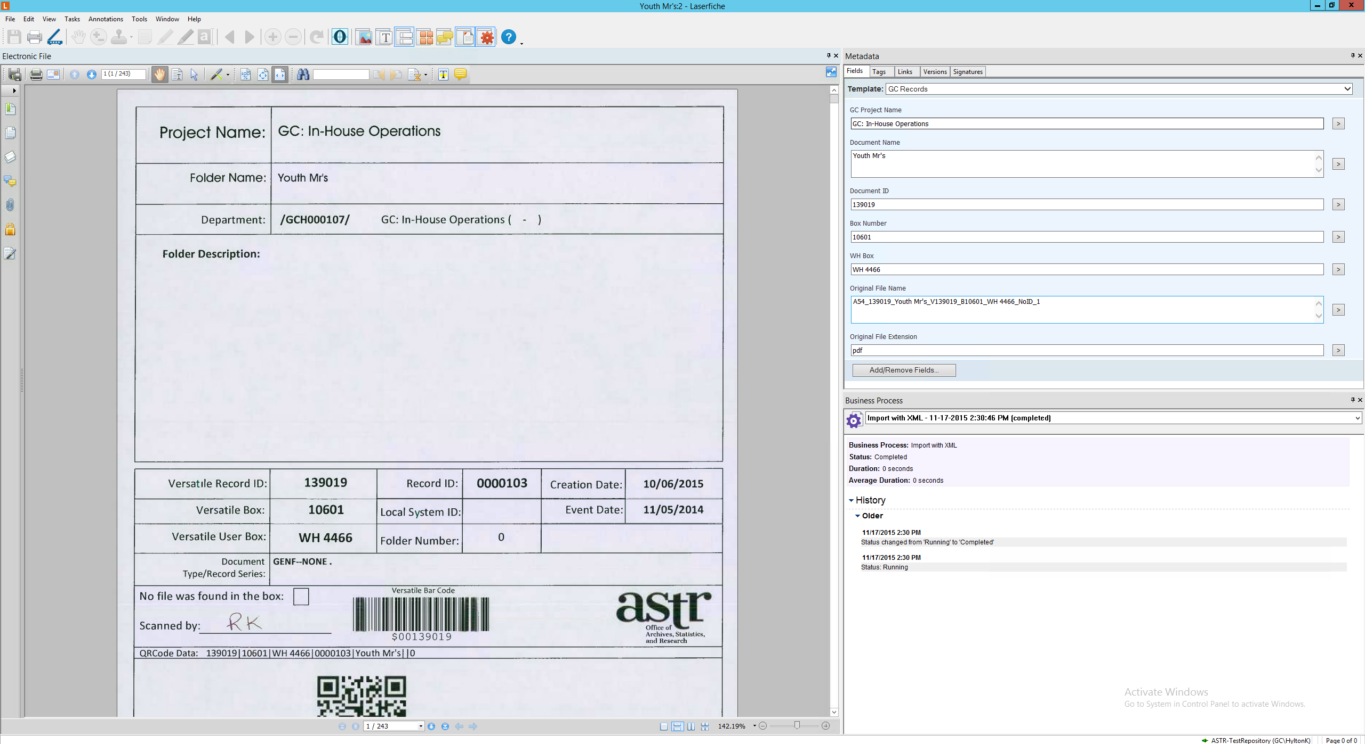

Slide 27
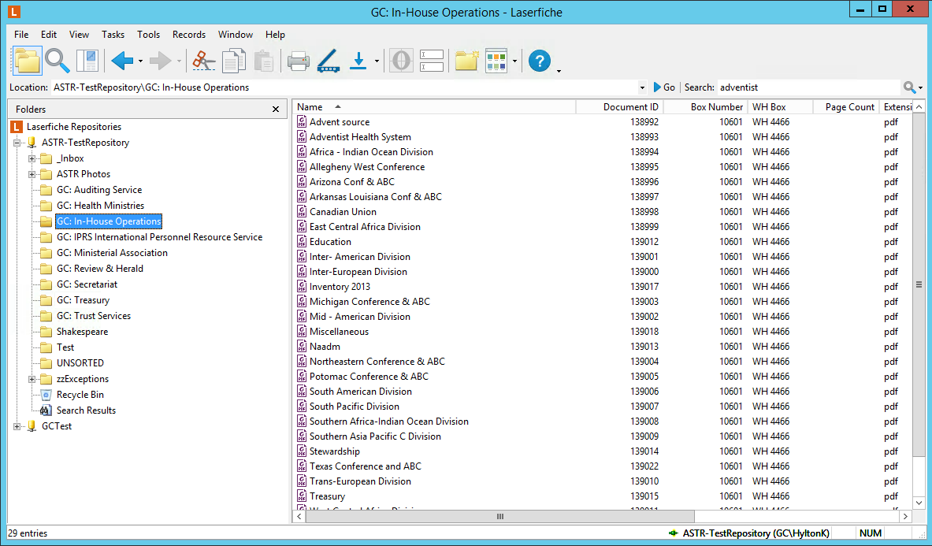

Slide 28
QUESTIONS

