Slide 1
Records Management Training 5/2019
West-Central Africa Division SDA
May 2019
Roy Kline, MHA
Assistant Director
Office of Archives, Statistics, & Research
kliner@gc.adventist.org
(1) 301-680-5026

Slide 2
REMEMBER
The value of Information is directly related to its accessibility.

Slide 3
Training Session Overview
Principles of Records Management
Goals for Records Management
Records Management Terms
Record-Keeping Challenges
Resources
Build on Success

Slide 4
Eight Principles of Recordkeeping
1) Principle of Compliance The recordkeeping program shall be constructed to comply with applicable laws and other binding authorities, as well as the organization’s policies.
2) Principle of Availability An organization shall maintain records in a manner that ensures timely, efficient, and accurate retrieval of needed information.
3) Principle of Retention An organization shall maintain its records and information for an appropriate time, taking into account legal, regulatory, fiscal, operational, and historical requirements.
http://www.arma.org/r2/generally-accepted-br-recordkeeping-principles

Slide 5
Eight Principles of Recordkeeping
4) Principle of Accountability An organization shall assign a senior executive who will oversee a recordkeeping program and delegate program responsibility to appropriate individuals, adopt policies and procedures to guide personnel, and ensure program auditability.
5) Principle of Integrity A recordkeeping program shall be constructed so the records and information generated or managed by or for the organization have a reasonable and suitable guarantee of authenticity and reliability
6) Principle of Protection A recordkeeping program shall be constructed to ensure a reasonable level of protection to records and information that are private, confidential, privileged, secret, or essential to business continuity
http://www.arma.org/r2/generally-accepted-br-recordkeeping-principles

Slide 6
Eight Principles of Recordkeeping
7) Principle of Disposition An organization shall provide secure and appropriate disposition for records that are no longer required to be maintained by applicable laws and the organization’s policies.
8) Principle of Transparency The processes and activities of an organization’s recordkeeping program shall be documented in an understandable manner and be available to all personnel and appropriate interested parties.
http://www.arma.org/r2/generally-accepted-br-recordkeeping-principles

Slide 7
What to do with all your documents?

Slide 8
Goals for Records Management
1) Policies and Procedures: Produce a written document that outlines your records management and archival policies. Produce a second (or attached) document that outlines the procedures that you will use to fulfill your policy.
2) Records Inventory: Conduct a general records inventory to find out:
What records are being produced and kept;
and
The various record types and the approximate volume of records that are stored in each office.

Slide 9
Goals for Records Management
3) Designate a filing system: Decide what type of filing system (paper in filing cabinets, film, electronic or some combination) best suits your needs, and follow it to the degree that is most practical.
4) Records Storage Facility: Choose a facility for the storage of records that are useful, but that are no longer needed in the office. Be sure that the facility is secure and protects the records.

Slide 10
Goals for Records Management
5) Records Retention Schedule: Prepare a document that states your record retention policy and the procedures needed to follow it. Keep that document with your retention schedule.
6) Vital Records: Your vital records are records without which you could not operate. Create a document that lists the criteria a record must meet to be considered vital and the procedures that will be used to preserve those records

Slide 11
Questions so far?

Slide 12
Records Management Terms (1 of 3)
Archival Record: Permanent record which is inactive and no longer needs to be housed in the office in which it originates. These records are of enduring value, and document the history and the development of the organization.
Archives: An area used for the permanent storage of valuable records and documents for the benefit of scholars and for future generations.
Case file: Record groupings that pertain to a specific action, event, person, place, thing, organization, location, program or project. Includes personnel, project, and transaction files
Disposition: The action taken, regarding records no longer needed for current business, which may include changing the location or physical format of the records. Action may include shredding or recycling, digitizing, microfilming, duplication, or transferring to records center or archives

Slide 13
Record Management Terms(2 of 3)
Life Cycle of Records: Records management’s three stages of a record: creation, maintenance and use, and disposition.
Off-site Storage: A facility other than the normal place of business where records are stored for protection.
Office of record: The office that originates and maintains an "official record" copy of a document, as opposed to a duplicate copy.
Permanent Record: A record which has a permanent or lasting administrative, legal, fiscal, research or historical value and therefore must be retained and preserved indefinitely.
Personal Papers (Personal files or personal records): Materials belonging to an individual that are not used to conduct agency business or that are used exclusively for that individual's convenience. Must be clearly designated as such and kept separate from the agency's records.

Slide 14
Records Management Terms (3 of 3)
Records Series: A group of identical or related records that are used, filed, and disposed of in a similar fashion.
Records Inventory: A survey of records to determine the size, scope, and intricacy of the department/agency’s records. It should include the record series, inclusive dates, types of records, quantity, arrangement, & description.
Records Manager: The person assigned primary responsibility for the records management program.
Records Retention Schedule: Instructions for what to do with public records (based on administrative need and legal requirements) from their creation, through active and inactive use, to their destruction or retirement. The schedule provides a minimum period of time that a specific type of record must be preserved.
Retention Period: The period of time during which records must be kept before they are either destroyed or stored in an archival area
Topical Systems: Classifying information according to topic, then filing the topic files in alphabetical order. Related topics are not kept together in this system.

Slide 15
Record-Keeping Challenges
Managing various records media
Record Retrieval
Record Storage Space
Records Retention
Maintaining the security & integrity of records
Social Media
Dynamic Documents
BYOD such as smart phones & tablets
Archiving Web sites
Archiving electronic data such as E-Journals

Slide 17
Questions so far?

Slide 19
Record Retention Issues
Records Media
Storage issues
Retention Concerns
Creating a Retention Schedule & sample forms
What to keep, what to toss, & what to archive

Slide 20
Record Interdependence
Archive
Research
Historic Preservation
Promotion
Records Center
Storage
Disposition
Active Records
Creation
Distribution

Slide 21
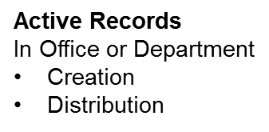
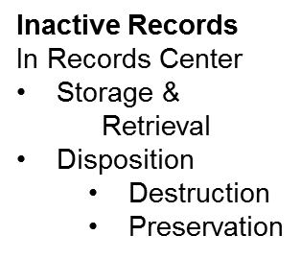
Records Life Cycle

Slide 22
Records Media We’ve gone from this . . .

Slide 23
Records Media . . . . to this and . . .

Slide 24
Records Media have ended up with this.

Slide 25
?

Slide 26
Records Media
Paper
Readable – Person
Storage -- Bulky & high volume
Life -- 20 to 100 year with minimum care
Retrieval -- Labor intensive
Distribution -- Slow & limited

Slide 27
Records Media
Microfilm/Microfiche
Readable -- Person + magnification
Storage -- 98% less space than paper
Life --100 years if stored under proper conditions
Retrieval -- Labor intensive
Distribution -- Limitations similar to paper
Document preparation -- Necessary
Quality Control – Automated

Slide 28
Records Media
Electronic -- CD, DVD, Flash drive, Hard drive, etc.
Readable -- Machine readable only
Storage -- Stores records in less space than microfilm
Life -- 5 to 30 years; however, the rapid advance of technology makes electronic media obsolete in about 5 years
Retrieval -- Rapid and not labor intensive
Distribution -- Rapid, many recipients, vast area
Document Preparation -- Necessary (if scanning)
Quality Control -- Visual on a per image basis

Slide 29
Records Retrieval Issues
Create and maintain an index of records in the Records Center/Archives.
Organize the records index by department and record type that will help when doing searches and retrievals.
After processing records into the Records Center/Archives send a report to the department or office that sent the records.
Store the boxes in the Records Center/Archives by box number rather than by department; boxes will be easier find and it will result in a more efficient use of space.

Slide 31
Storage Issues
Record Use – The more frequently a record is used the closer it needs to be to the office using it. Records that require immediate retrieval should be stored electronically.
Records Media – Different records media have different storage requirements that need to be considered.
Hazards – Records are threatened by a variety of hazards, some more likely than others. Some of the most common hazards are: fire, water, mold, theft, vandalism, vermin, and the mishandling or misfiling of records. In order to use your resources to their fullest, evaluate the threats to your records and protect against the most likely threats.

Slide 32
Storage Options
Self-Storage
Pros – retain control of records, easier & more immediate access to records
Cons – need to find and maintain adequate, secure space, personnel and administrative costs
Commercial Records Storage
Pros – lower administrative costs, lower cost per box for storage -- depending on volume
Cons – higher cost of retrieval, access to records less convenient, no physical control of records, cost to retrieve records if you discontinue service
Cloud Storage
Pros – no cost for server, records readily available over wide area
Cons – Security, doesn’t control records, reliability of service provider

Slide 33
Questions so far?

Slide 34
Retention Issues
Time
Permanent or indefinite: If it is already decided that a particular set of records is to be kept indefinitely, the only other consideration for that set of records is how and where to store them.
Regulations: Applicable National, State/Provincial and even Municipal regulations establish the minimum time period a set of records MUST be kept.
Business Use: The business use that a record supports often determines where and for how long a record is kept.
Media: The media on which the record is stored or produced is NOT a determining factor in deciding how long a record is kept (i.e. electronic correspondence and paper correspondence must have the same retention time).
Legal holds: Any records that have been subpoenaed, any records for which there is knowledge of impending litigation, or any records for which there is even reasonable suspicion that there will be litigation must not be destroyed. After the close of the litigation the records may then be re-evaluated for purposes of retention.

Slide 35
Retention Issues
Storage
Business Concerns:
Frequency of retrieval: Frequent retrieval and refiling would call for keeping files close by or even kept in digital form on-line.
Need for wide distribution: Records can be distributed quickly and economically when they are kept in digital form.
Retention Time: Longer retention requirements are better met by stable media less dependent on technology for readability. Retention periods longer than 10 years will require a migration strategy for digital records.

Slide 36
Retention Issues
Vital records:
Mission critical records without which the organization could not function (about 2% to 7% of an organization’s records)
Examples: charters, minutes, service records, property records, insurance policies, donor lists, and accounts receivable
Protection:
Redundancy: Keeping copies of vital records in a safe off-site location.
Vaulting: Keeping vital records in a location that is safe from physical hazards such as fire, water, mold and theft.

Slide 37
Retention Issues
Budget
Paper: Costs: printing, distribution, retrieval time, and storage space Note: In some cases it may cost less to store paper in commercial storage than to microfilm it.
Microfilm: Costs: document preparation, filming, distribution, retrieval, reader/printer, climate controlled storage.
Electronic: Costs: document preparation, quality control, indexing, computer workstation & server, periodic record migration.

Slide 38
Is this how you see Records Retention?
Retention may not be as much fun as a day at the beach, but it can improve your quality of life by freeing up filing space, making records storage and retrieval more efficient, and minimizing litigation risks.

Slide 39
Creating a Retention Schedule (1 of 3)
Create a statement declaring the scope and purpose of your record retention schedule.
Have the statement reviewed and endorsed by top management.
Establish the procedures necessary for creating the Record Retention Schedule.
Document the process of creating the retention schedule.
Retain the documentation as an audit trail for establishing and following the retention schedule.

Slide 40
Creating a Retention Schedule (2 of 3)
Contact your records manager (designate someone if necessary) to coordinate the process.
Inventory all current records (including all media types) maintained in the office to which the retention schedule is to apply.
Create a master list of record types and draft a preliminary retention schedule.
Determine retention periods on the basis of legal, administrative, and historical value.

Slide 41
Creating a Retention Schedule (3 of 3)
Obtain approval from relevant areas with oversight responsibility (i.e. IT, finance, or legal)
Publish, distribute and follow the Retention Schedule
Review the retention schedule at regular intervals (i.e. annually, biannually, etc. )

Slide 42
Sample Records Inventory Procedure
Inventory forms collated and information put into a draft records retention schedule by Archives.
Draft retention schedule reviewed and edited by department management.
Department management to meet with Archives to put retention schedule into final form, pending review by Office of General Counsel (OGC).
On approval of Legal (OGC) the retention schedule becomes official until there is a future revision.

Slide 43
Sample Records Inventory Form

Slide 44
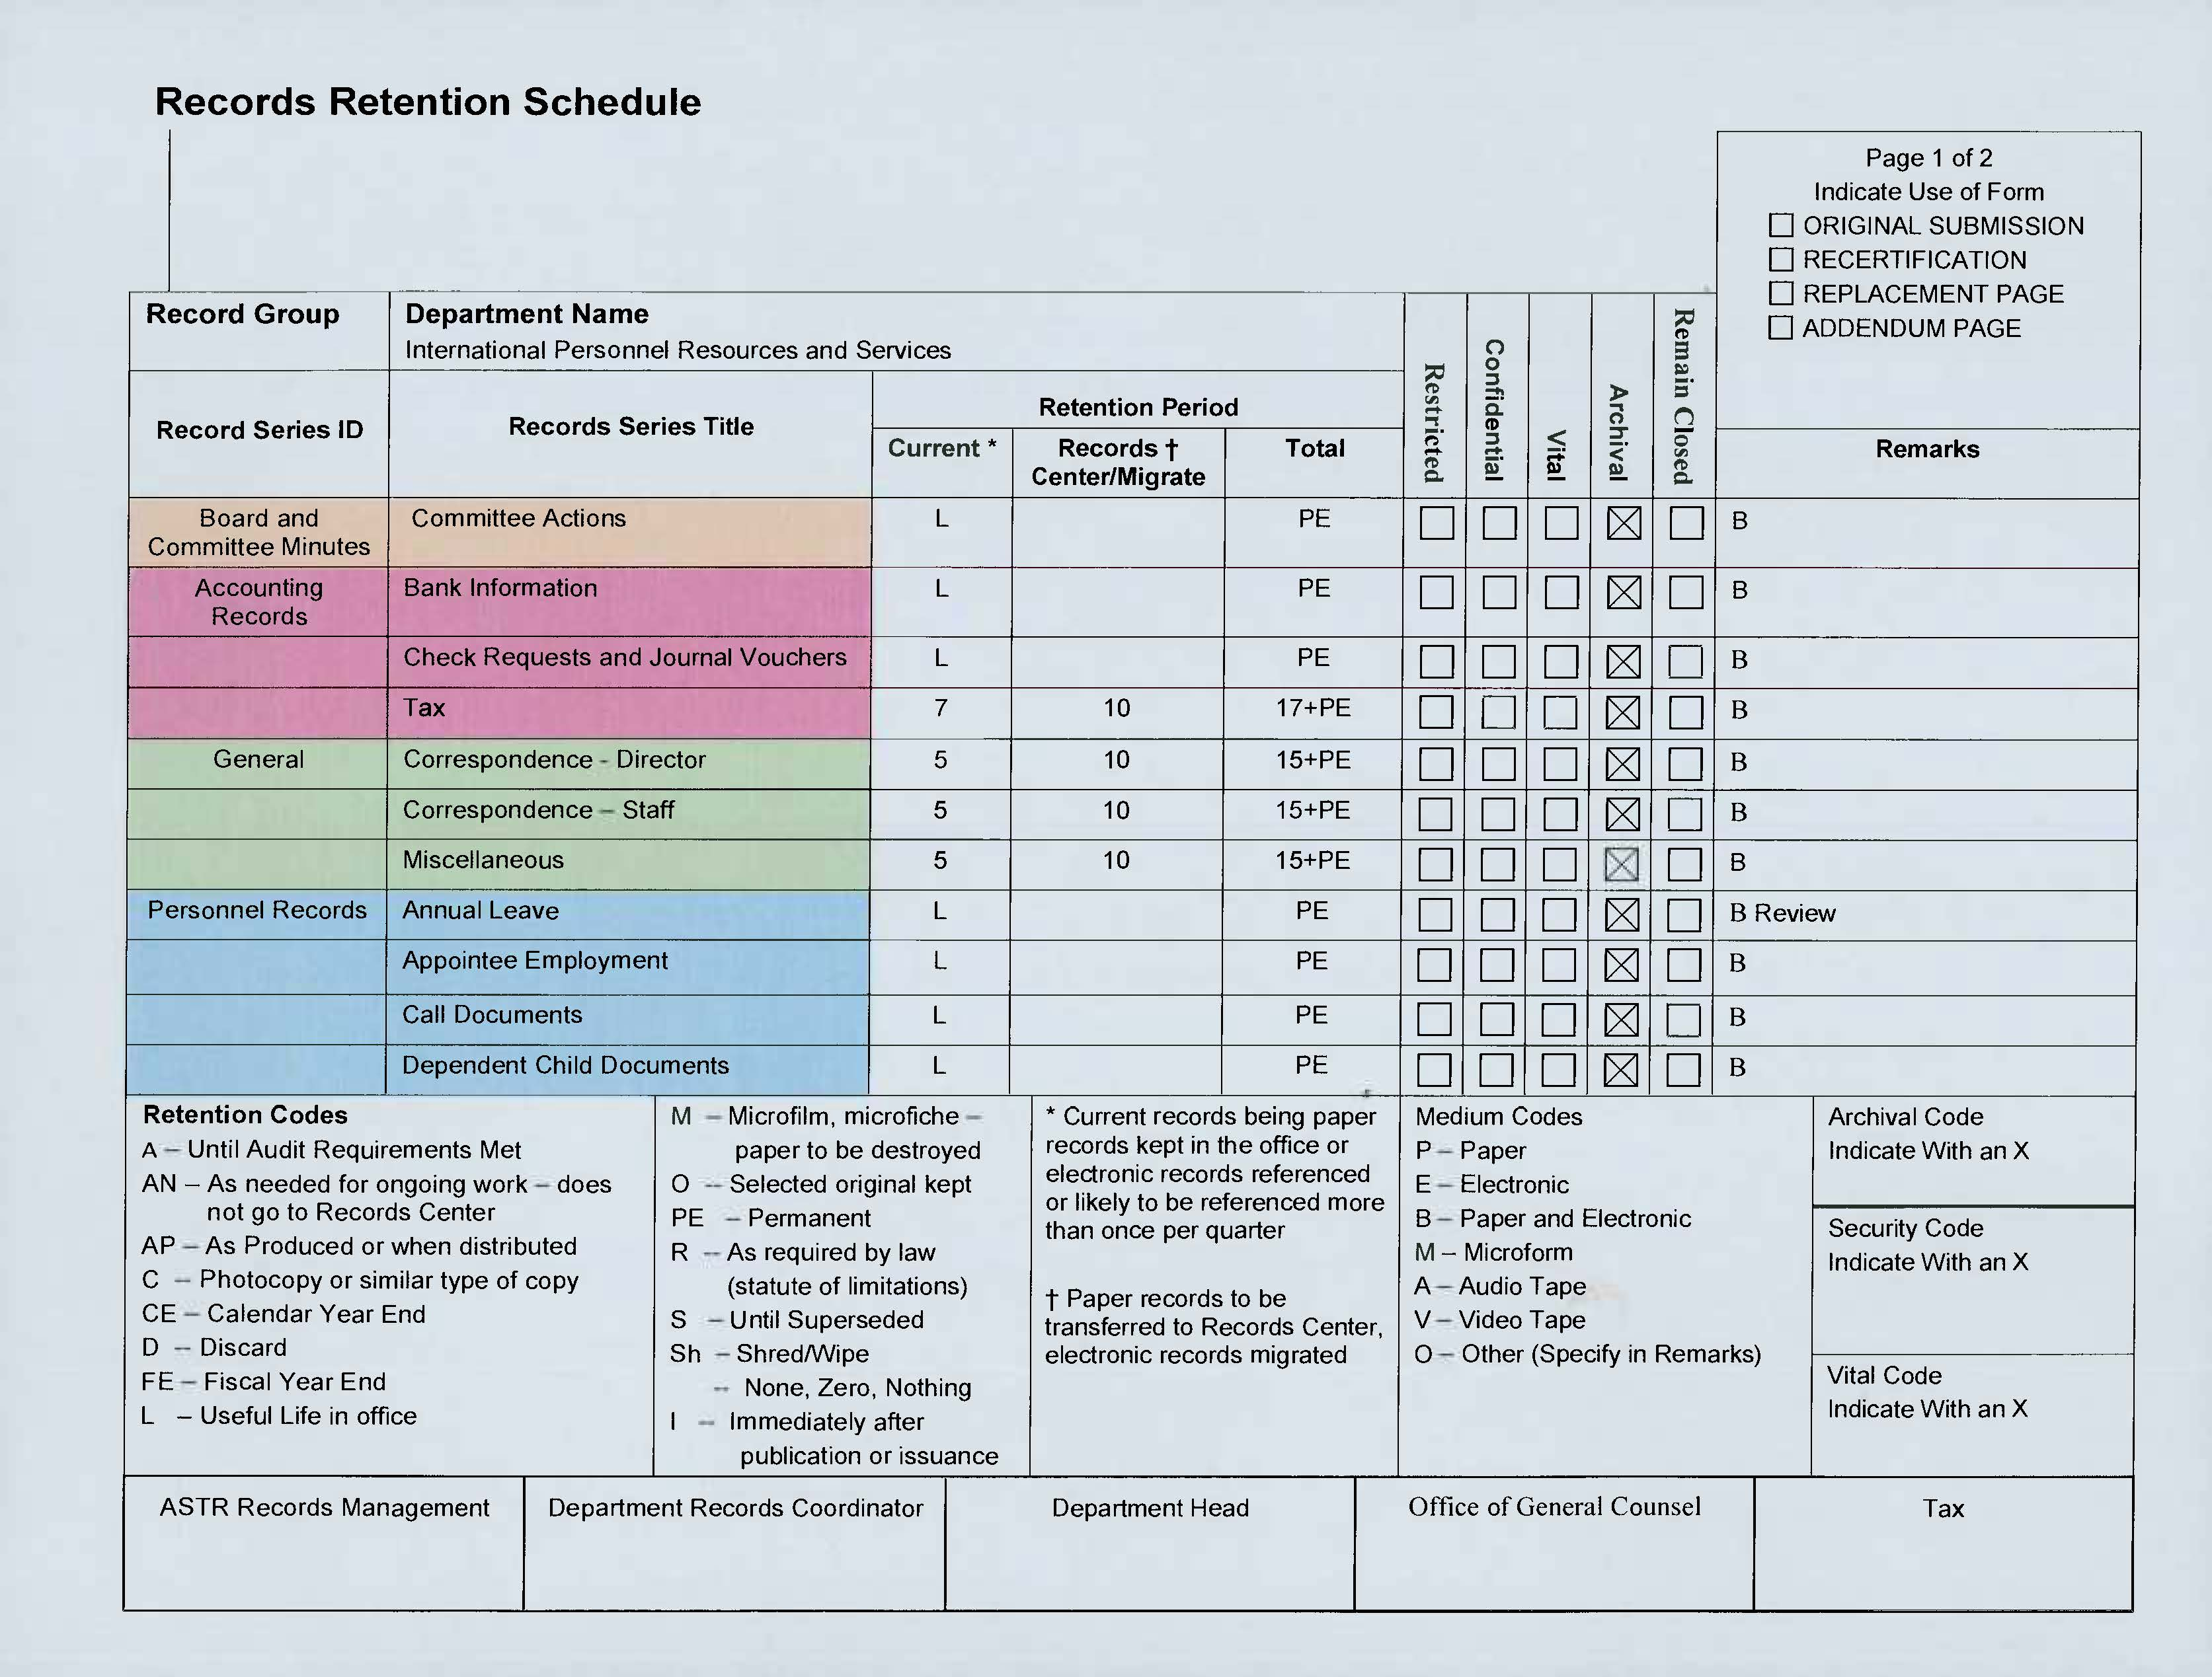

Slide 45
Sample Retention Schedule Form

Slide 46
Questions so far?

Slide 47
What to Keep
Correspondence
Dealing with policies, administration, personnel, projects, statistics, final travel itinerary, set of original form letters
Minutes
Produced by your department or for which someone in your department is the chair
Case files
Topical files
Material published by your department
A/V material (videos, photos, pod casts), a copy of reports or brochures

Slide 48
What to Toss
Routine requests – catalogs, brochures, services
Circular memos from other offices
Correspondence concerning travel planning
Non-SDA published or duplicated material
Temporary financial records – phone bills, purchase orders, monthly financial statements

Slide 49
What to Archive
Think of your Archive as the corporate memory.
You would want to save records:
portraying beginnings, changes, endings
dealing with cases, events, problems, projects that reveal the purpose and function of the organization
documenting relationships with other denominational organizations

Slide 50
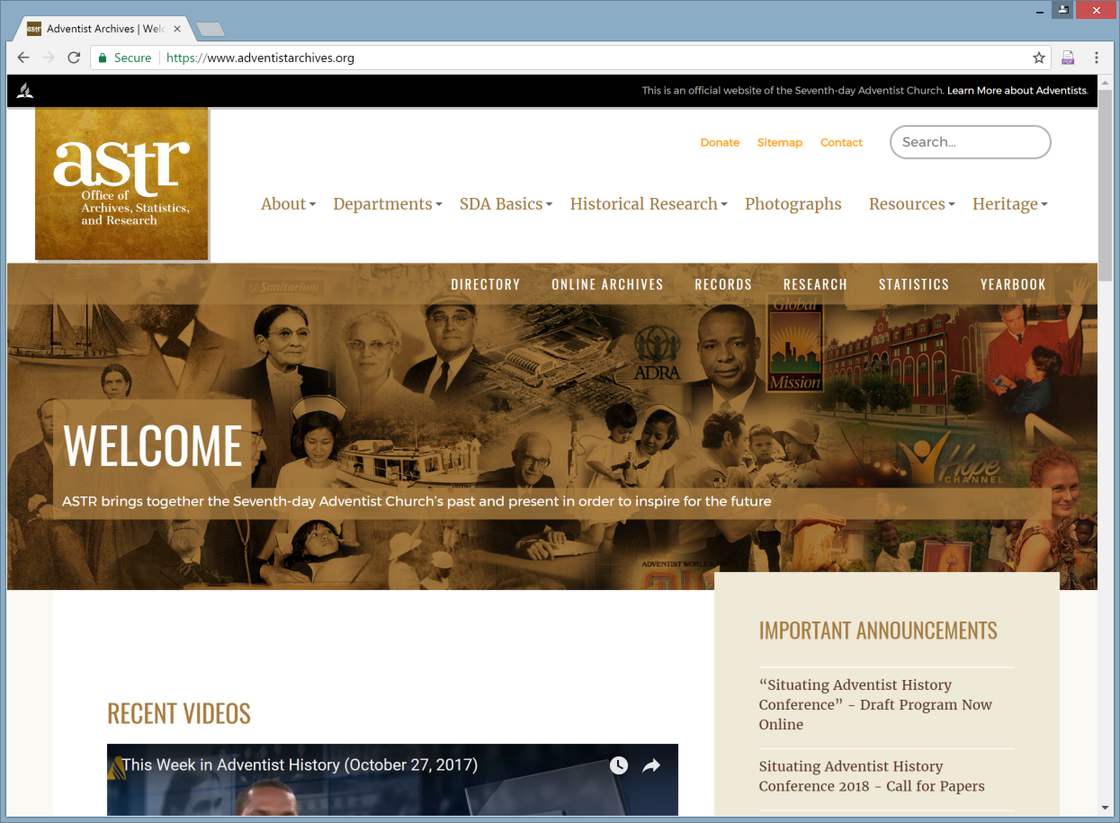
Archives Web Site

Slide 51
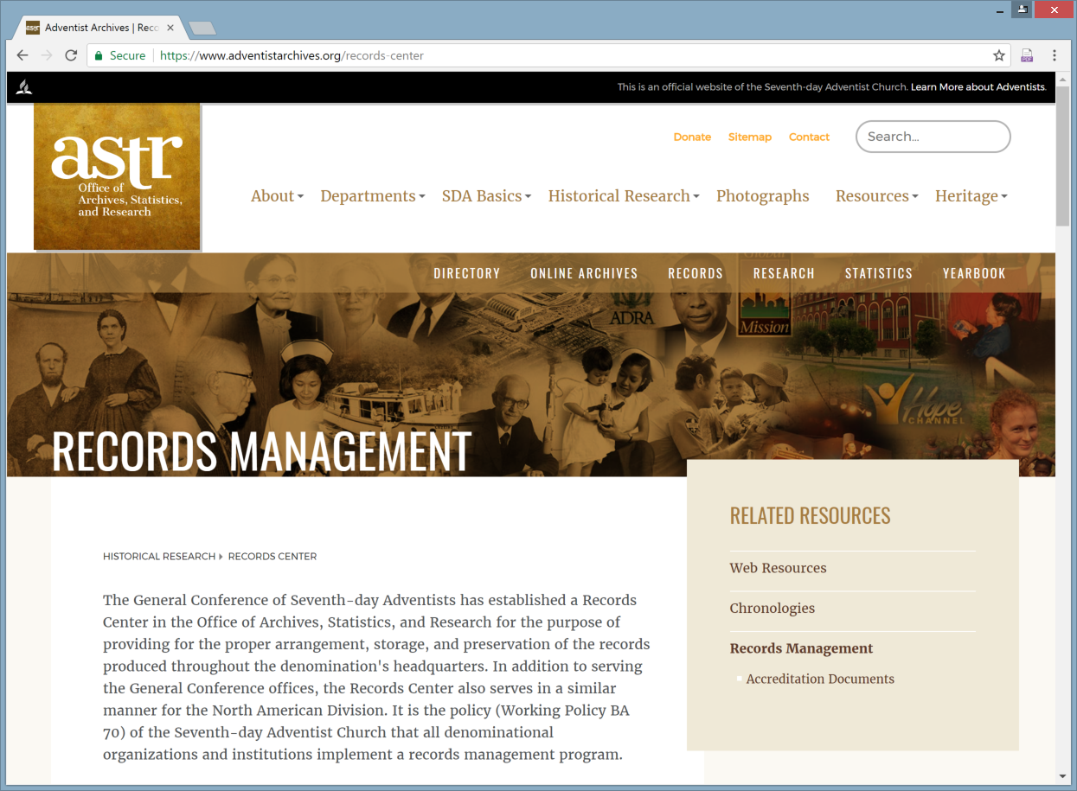
Records Center Web Page

Slide 52
Resources: Web Sites (1 of 2)
General Conference
General Conference Web site: http://www.adventist.org
Archives Web page: http://www.adventistarchives.org/
Records Center Web page: https://www.adventistarchives.org/records-center
Online Archives: http://documents.adventistarchives.org/default.aspx
Yearbook page: http://www.adventistyearbook.org/default.aspx
Organizational Directory page: http://www.adventistdirectory.org/
Statistics page: http://www.adventiststatistics.org/
Archives & Records Management
ARMA International: http://www.arma.org
(Association of Records Managers & Administrators)
Association of Seventh-day Adventist Librarians http://www.asdal.org
Society of American Archivists: http://www2.archivists.org
National Archives and Records Administration (US): http://www.archives.gov
National Archives (Australia): http://www.naa.gov.au
UNESCO Archives Portal: http://www.unesco.org/archives

Slide 53
Resources: Web Sites (2 of 2)
Disaster Recovery
Disaster Recovery Journal: http://www.drj.com
Disaster Recovery Planning Directory: http://www.disasterrecoveryworld.com
Disaster Recovery Planning Guide: http://www.disaster-recovery-guide.com
Contingency Planning & Disaster Recovery: http://www.disasterplan.com
Electronic Records
Long Term Preservation of Authentic Electronic Records: http://www.interpares.org/book/index.htm
Overview of Technical Approaches to Digital Preservation and Challenges: http://www.clir.org/pubs/reports/pub107/thibodeau.html
Authenticity in a Digital Environment: http://www.clir.org/pubs/reports/pub92/contents.html
Preserving the Authenticity of Contingent Digital Objects: http://www.dlib.org/dlib/july00/eppard/07eppard.html

Slide 54
Build on Success
Start small, one department or one record group at a time. One way to ensure failure is to try and do everything all at once.
Make the retention schedule as generic as possible.
Make the retention schedule, as well as your records management system, as transparent and easy to follow as possible. The measure of its success is the degree to which it is understood and followed.

Slide 55
Electronic Records

Slide 56
Questions ?

