Slide 1
Servant Leadership
An Oxymoron?
International Conference for College and University Presidents
March 25, 2014
Notes:
I was the newly minted Conference President of the Georgia-Cumberland Conference. It was my first Sabbath appointment and I was scheduled to offer the dedication prayer at the Jasper Seventh-day Adventist church. My wife and I rose early to make the one hour drive to the church from our home in Collegedale, Tennessee. We arrived well before the 9:30 AM Sabbath School and my first impression was that the church had not planned for my arrival. I didn’t expect a band to announce my arrival but the pastor seemed perplexed and surprised to see me.
A few phone calls later I became aware of the fact that I had driven to Jasper, Tennessee instead of Jasper, Georgia where the special service was planned. Two hours later we arrived at the Jasper, Georgia church in time for the potluck, much to my embarrassment, and the amusement of the congregation and particularly the conference officers who were at the special service.
It was not an auspicious beginning to my leadership of the conference. The following week at the Conference office morning worship the staff had a great time providing me with maps of the conference territory and making me the butt of more jokes than I can remember. It was obvious that I didn’t come to the conference office with all of the answers.
There was the time that I was getting on a freeway onramp. It was a broad onramp with two lanes merging onto the freeway. There was this car riding my bumper. The moment I turned onto the onramp he pulled to the other lane to get past me and … well … I floored it! We were drag racing down the on ramp to about 90 miles an hour.
Why would I do that – what is the competitive bug in my genes – what is the desire to be – faster – stronger – more powerful. If you were an evolutionist you could answer that question easily – and I suppose as a Christian creationist the answer is easy also – selfishness – ego.
By the way as I reached the freeway I slowed down and the other driver cut over to the fast lane and continued his high speed and much to my – should I say – satisfaction – there was a policeman who was there to pull him over and I had a great temptation to wave at him as I went by – I didn’t but my heart was waving.

Slide 2
Oxymoron
Rap music
Working vacation
Exact estimate
Peace force
Temporary tax increase
Notes:
Servant Leadership – seems like a contradiction in terms.
The quest for power and the desire to be first is not found only in the hearts of the heathen.
I always knew I would someday be a president – when I was born my Dad was president of a conference. Jim and John probably felt like I did. A desire to be lifted up. There is in my heart, not readily recognized, a desire for position, for leadership, not always to fulfill my gifts but at times to fulfill my ego desires.
Jim and John had been working on the campaign trail for more than a year.
They had left their families and good jobs and for 18 months they slogged the campaign trail working to elect their leader.
They had been there when CNN accused him of being a drunkard.
They had been by his side when the opposition party dug up that story about his parentage. The lead article that reported the story actually called him a bastard.
Their point was that they had been there, … been there for him during the tough times and now as it looked like the campaign was about over they were seeking a bit of quid pro quo. That is Latin for, “We scratched your back and now you should scratch ours.”
Or as we might say in the church “I invited you to my college to speak and now it is time for me to get an invitation to your university.”
It looked like their candidate was going to win; cabinet posts and special appointments would soon be distributed and they wanted a good position. They were like family, they belonged to the same tribe. It was time to be rewarded.

Slide 3
Mrs. Zebedee seeks position for her children. Matthew 20:20-21
Then the mother of Zebedee's sons came to Jesus with her sons and, kneeling down, asked a favor of him.
"What is it you want?" he asked. She said, "Grant that one of these two sons of mine may sit at your right and the other at your left in your kingdom."
Notes:
And so we read in Mark 10:35-37
……
We want to be in charge! We want power!
Right hand man and left hand man!
We would like some cabinet posts.
Actually in Matthew’s version of the event James and John get their mother to ask for them. There is political manipulation for you. They managed to get their mother onto the nominating committee.
The procession to Jerusalem was looking for all the world like a triumphant march and James and John were not about to be left holding the bag. No sir!
They had enough of:
No more small jobs for them.
No more running errands for others, it was time for someone to run errands for them.
No more measly secretarial work
Rumors were flying,
Jesus would be king.
The Nominating Committee was meeting very soon.
Their time of destiny was close at hand.
So they went to Jesus and said, “Let one of us sit at your right and the other at your left in your glory.”
“Oh the glory! We want some of that glory, that power, that position!”
The longing of James and John is similar to our longing and it is the same longing that Lucifer had. He also aspired to glory!

Slide 4
Isaiah 14:13-14 (NLT)
¹³ For you said to yourself,
‘I will ascend to heaven and set my throne above God’s stars.
I will preside on the mountain of the gods
far away in the north.
¹⁴ I will climb to the highest heavens
and be like the Most High.’
Notes:
READ SLIDE
What was in the minds of James and John?
What was going through their heads?
What was in their minds is the same thing that is in our minds when we fantasize about positional power and authority.
Isn’t that what leadership was about?
Isn’t leadership about leading, being in charge, controlling, having power, headship, being the chief, on top, primary, prominent?
There is a desire basic to fallen human nature that:
Wants to be in control, not controlled,
Wants to be in charge, not subservient.
Wants to be leading, not following.
Wants our own destiny in our hands, not in the hands of others.
Kent Keith
“The feeling of having no power over people and events is generally unbearable to us – when we feel helpless we feel miserable.”
James and John sought positional leadership to fulfill an inner emptiness.
Thinking that: It is the bigger school that will satisfy.
It is the higher position that will satisfy.
It is being president – that will satisfy.
Ibid

Slide 5
Positional Status
Mrs. Zebedee thought a position would give her and her sons status.
The world seeks status through money position and power.
James and John were not much different than we are - feeling like a certain position will satisfy.
Notes:
But the hole of personal emptiness is no more filled by position than
the lust for riches is filled by a raise or
the ocean is filled by an eyedropper.

Slide 6
The world teaches us that we have no value unless we compete with others showing that we are better than they are.
Winners
Losers
Notes:
READ SLIDE

Slide 7
Success by Comparisons
Strength is used by strong
Beauty is used by the beautiful
Money is used by the rich
Brains are used by the smart
Notes:
READ SLIDE

Slide 8
Comparisons are Odious
We do not dare to classify or compare ourselves with some who commend themselves. When they measure themselves by themselves and compare themselves with themselves, they are not wise.
2 Corinthians 10:12
Notes:
READ SLIDE
Have you ever wished that your school was as large as that other school?

Slide 9
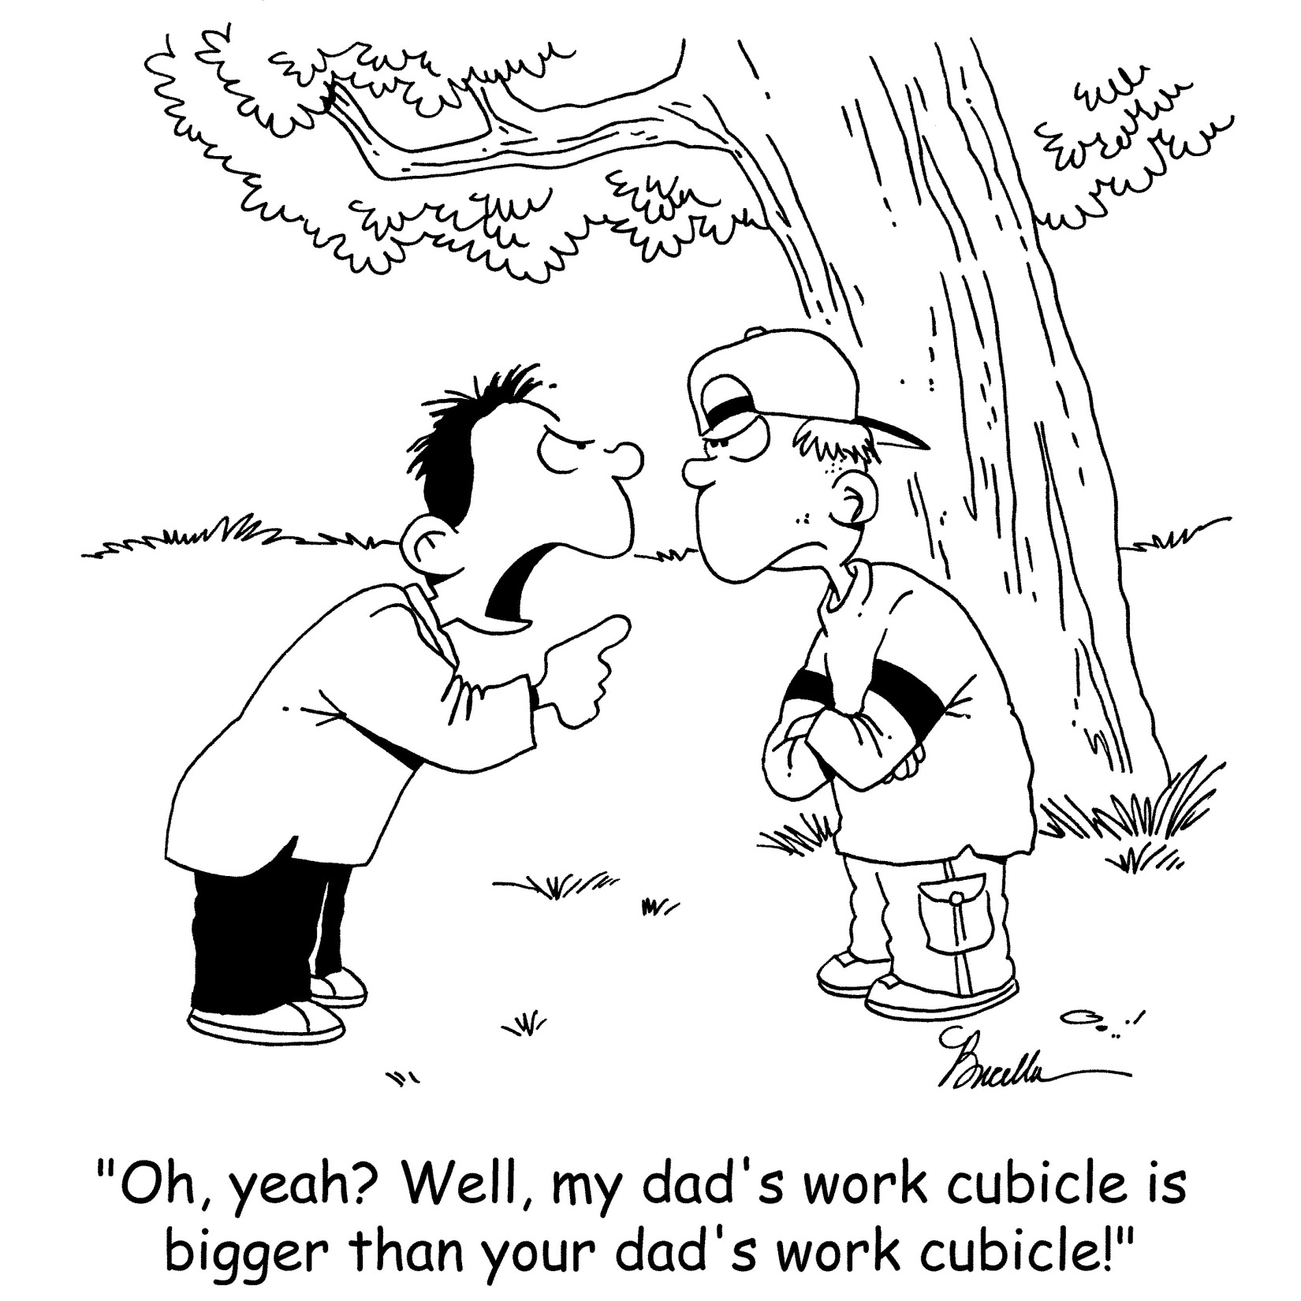
Notes:
READ SLIDE
How did Jesus respond to James and John and their desire for glory?

Slide 10
Jesus Responds to
Mrs. Zebedee’s Request
“to sit at my right or left is not for me to grant. These places belong to those for whom they have been prepared by my Father." Matthew 20:23
Notes:
READ SLIDE
Notice that Jesus doesn't condemn James and John.
He doesn’t say, “You selfish disciples - get behind me Satan.”
He doesn’t say, “You shouldn’t seek to have any position like that.”
He doesn’t criticize their desire for leadership.

Slide 11
Right Goal!
Wrong Methodology!
Their goal of success was good.
Their methodology of seeking position to find success was wrong.
Notes:
He just says:
“to sit at my right or left is not for me to grant.”
“It isn't up to me to make that decision.
“Sorry, I can’t choose the vice presidents, the Nominating Committee does that!”
“We have a search committee and it is not up to me to choose the College President.”
You know that might have been the end of the story except for Twitter and Facebook.

Slide 12
“When the ten heard about this, they were indignant with the two brothers.” Matthew 20:24
They were probably “indignant” because they didn’t think of it first.
Notes:
Why were they so indignant?
There are none as indignant as those who catch someone else doing something that they wish they would have done.
“Why didn’t we think of that?!”
“Did you hear that James and John asked the president if he would appoint them as vice presidents?” “Can you believe it?”
“I heard that James and John got their mother on the Nominating Committee and she proposed that they be secretary and treasurer of the conference? Of all the arrogance.”
Jesus decided that he needed a session with all the disciples together.

Slide 13
Jesus responds
Jesus called them together and said, "You know that the rulers of the Gentiles lord it over them, and their high officials exercise authority over them.” Verse 25
Notes:
Jesus starts out by describing the way it is in the kingdom of the world.
In the kingdom of the world presidents lord it over them.
In the kingdom of the world High officials exercise authority over them.
In the kingdom of the world the president thinks his opinion has more value than the vice-president’s opinion.
There are power conflicts everywhere in the world – and unfortunately in the church as well.
Ill.
In one of my first meetings with a church as the new conference president one deacon wanted to settle the score with another church leader by going out into the church parking lot and having a fist fight.
At another church I visited the leaders in the church provided me with physical protection because they were concerned about my physical safety.
The church, the university or college– our institutions are not exempt from the ego driven desire to have power and control.
Jesus says:
You know the old way -the way of the worldly kingdom.
Striving to beat out others for positional leadership.
Asking for favors - some quid pro quo.
Being very friendly to the people on the Nominating Committee
After Jesus describes the way leaders function in the worldly kingdom He describes His New Kingdom.

Slide 14
Jesus Continued:
Not so with you. Instead:
whoever wants to become great among you must be your servant,
and whoever wants to be first must be your slave” Verses 26-27
Notes:
Rather than condemning the two ladder climbing disciples Jesus told them how to get up the ladder and achieve their goal.
Congratulations! You want to be on my left and right, you want to be Vice Presidents? – This is how you do it.
You want to be successful – this is you strategy.
You want to be president – this is the way you do it.
You want to be a leader – in my kingdom this is how it works.
Their goal was good; their methodology was wrong.
So Jesus gives the strategy for leadership in His kingdom.
This is the lecture on leadership by Jesus.
This is His management style
This is the secret of success in His University.
“whoever wants to become great among you [Your want to be great - this is how.]
must be your servant, and whoever wants to be first [You want to be first here is your strategy.]
must be slave of all.”
It is a paradigm shift for leadership.
This is turning upside down normal thinking on positional power based leadership.
This doesn’t compute in our human brains when we have been so accustomed to thinking in terms of power and control, having control, gaining control, being in charge.
It is not clear how Jesus’ management methodology works.
How does being a servant make you great?
Will being a servant get your picture on the front page of the Review?
How will you get that job without a little politicking?
How will being a slave result in you moving up the ladder of leadership?

Slide 15
Discussion
You have Two Minutes
Time is up!!!!
You have Three Minutes
How does being a servant make you great?
How does being a slave make you first?
You have One Minute
Notes:
ASK FOR RESPONSE
Jesus strategy for leadership turns our ideas on their head.

Slide 16
True Leadership
Oswald Sanders has pointed out that "true leadership is achieved not by reducing men to one's service but in giving oneself in selfless service to them." Preaching-Vol. 1
Notes:
After his leadership lecture Jesus says in Mark 10:45
NEXT SLIDE

Slide 17
Jesus illustrates the leadership of servanthood
“just as the Son of Man did not come to be served, but to serve, and to give his life as a ransom for many." Verse 28
Notes:
Jesus embodied His theory of leadership.
Jesus asks us to be leaders as he led.
The same servant leadership principles are in the Old Testament.
You remember the story of Moses and his challenge of leading the children of Israel to the Promised Land. He took them to Mt. Horab – the mountain of God. And when his return from the top of the mountain was delayed the people demanded of Aaron to build a golden calf. Moses comes down the mountain and stops their orgy of worship before the golden calf and then:

Slide 18
Exodus 32:30 (NLT)
...Moses said to the people, “You have committed a terrible sin, but I will go back up to the Lord on the mountain. Perhaps I will be able to obtain forgiveness for your sin.
Notes:
READ SLIDE
So Moses climbs the mountain again and says to the Lord:
NEXT SLIDE

Slide 19
Exodus 32:31–32 (NLT)
…“Oh, what a terrible sin these people have committed. They have made gods of gold for themselves. ³² But now, if you will only forgive their sin—but if not, erase my name from the record you have written!”
Notes:
Are we servant leaders like that?
Would we be willing to lose our salvation to save the people we serve?
Would you give up your eternal life for that problem faculty member?
Would you give up your eternal life for that Board of Trustee member who is a thorn in your side?
This idea about being a servant leader was not just a singular thought of Jesus but was a theme of His ministry:

Slide 20
Mark 9:33–37 (NLT)
After they arrived at Capernaum and settled in a house, Jesus asked his disciples, “What were you discussing out on the road?” But they didn’t answer, because they had been arguing about which of them was the greatest. He sat down, called the twelve disciples over to him, and said, “Whoever wants to be first must take last place and be the servant of everyone else.”
Notes:
Servant leadership was the life of the Savior.
Remember – it is possible to be too big for God to use you;
but you are never too small for God to use you.
Jesus didn’t just preach servant leadership, he lived it.
Tan, P. L. (1996). Encyclopedia of 7700 Illustrations: Signs of the Times. Garland, TX: Bible Communications, Inc.

Slide 21
Jesus the Servant
He came not to show off his worth,
  He came to give us worth.
He came not to enrich Himself at our expense
  He came impoverishing Himself to make us rich.
He came not to impress us with His glory.
  He came to share His glory with us.
Notes:
God does want us to be great. He needs presidents, vice presidents, treasurers and secretaries. God does want us to perform great works for the kingdom. But God has His own standards.

Slide 22
Successful servant leadership is serving others so they can reach their goals rather than feeding on others so we can reach our goals.
Notes:
How many times do we get friendly with people because of what they can do for us?
How many times to we connect with that person on the Nominating Committee because they have influence on our career?
How many times do we reach out to that person who has a lot of money simply so we can get him to give it to the school.
So let’s get practical. What does Servant Leadership look like?

Slide 23
The secret of Christian leadership is not at the top of the pyramid but at the bottom.
Leadership in serving others,
not controlling others.
Notes:
Leadership from the base of the pyramid – not from the top.
This is simplistic but I would suggest that there are essentially two approaches to leadership

Slide 24
Two Approaches To Leadership
Personal dominance
  Unified, clear direction that is based in the worldview of the leader.
Interpersonal influence
  Direction is based on a negotiation of differences integrated in the leader’s perspective.
  “The deep blue sea rethinking the source of leadership” by Wilfred Drath
Notes:
READ SLIDE

Slide 25
Personal Dominance Leadership
I am in charge just do as I say!!
  What happens when there is a mistake?
Are there still some College Presidents that function that way?

Slide 26

Interpersonal Influence
You are in charge but we all have a part to play in influencing the ultimate decision.
  What happens when there is a mistake?
Mutual accountability
Notes:
READ SLIDE
The answer is turning the pyramid upside down.

Slide 27
Turning the pyramid upside down.
Students
Faculty
Departmental Directors
Vice Presidents
University President
Who does the University President serve?

Slide 28
Leadership Is Influence.
The lowest form of that influence is the influence you have because of a title or a position.
If your influence depends on the location of your office or the location of your box on the organization chart than your influence is probably minimal.
John Maxwell.
Notes:
READ SLIDE

Slide 29
Leadership is not only for:
Those who are elected to an office.
Those who have positions of authority.
It is exercised by anyone who influences another.
It is exercised by first year teachers and students.

Slide 30
Leadership
Is not a position granted by the President or the chairman of the board
It is not the president who empowers you.
It is not a title that you have.
It is not the power you have.
It is influence developed through servanthood.

Slide 31
The Hierarchy
Is this the only person who has information about how to do a task?
Boss
Is this the only person with influence?

Slide 32
So the servant leader values every person
Information for the organization exists at all levels.
Boss
Information
Wisdom
Data
Knowledge
Facts
Information
Information
Statistics
Knowledge
Data
Statistics
Wisdom
Knowledge
Information
Facts
Knowledge
Information
Wisdom
Facts
Notes:
Is all the information to do a job just located in your brain?

Slide 33


Slide 34
1. The Servant Leader Is Interested In Others
“Hanani, one of my brothers, came from Judah with some other men, and I questioned them about the Jewish remnant that survived the exile, and also about Jerusalem.” (Neh. 1:2)

Slide 35
Servant Leaders Like People
If you can't stand the smell of sheep, you shouldn't be a shepherd.
Notes:
If you don’t have an honest interest in others you can’t serve them.
If you don’t love people you can’t serve them.
I have a question:
Would you rather be a loving Atheist or a hateful Christian?
Would you rather be a loving Muslin or a hateful Christian?
Would you rather be a loving Catholic or a legalistic Adventist?
There are those who have elevated what they believe over how they behave.
What is the point of doctrines if it isn’t to make us more loving?
What is the point of teachings if it isn’t to help us love our neighbors?
What good is the truth if it doesn’t make us servant leaders?

Slide 36
Andrew Carnegie felt you develop people the same way you mine for gold. "In gold mining you must literally move tons of dirt to find a single ounce of gold.
However, you don't look for the dirt - you look for the gold." (Homemade, September 1992)
Notes:
As Lucy said in the peanuts cartoon strip. I love humanity it is people I can’t stand.

Slide 37
Ellen White
"But the early Christians began to look for defects in one another. Dwelling upon mistakes, giving place to unkind criticism, they lost sight of the Savior and of the great love He had revealed for sinners. They became more strict in regard to outward ceremonies, more particular about the theory of the faith, more severe in their criticisms. (8T 241)
Notes:
There is a leadership style that seeks to force obedience. It can even be a well-intentioned attempt to manipulate for Jesus. Too often we seek to mold people without melting them first with love.

Slide 38
2. The Servant Leader
Is Empathetic
They said to me, "Those who survived the exile and are back in the province are in great trouble and disgrace. The wall of Jerusalem is broken down, and its gates have been burned with fire." (Neh 1:3)
Notes:
What is your response to problems?

Slide 39
The Response Of Some
Relief
  “I am glad that it isn’t my problem.”
Assign blame
  “The walls are broken down – I wonder whose fault it was?
Satisfaction
  It looks like they finally got what was coming to them.
Pride
  “We are better than they are.”

Slide 40
Nehemiah’s Response
"When I heard these things, I sat down and wept. For some days I mourned and fasted and prayed before the God of heaven.” (Neh. 1:4)
Notes:
He cried!
When he heard of a problem a long way away he cried.
For the Servant leader - Leadership is experienced like in the family.
You don’t sense it as being above or over others.
You don’t feel it as being ahead of others but it is experienced simply as being a part of the whole.
Like an exposed nerve ending

Slide 41
Response Of The Body To Injury
Notes:
What happens when you are injured? Blood sends resources to fix the pain.
Ill. - Lost girl in fire
Hard phone calls but important to make

Slide 42
The Servant Leader Identifies With Problems?
"Then I said: "O Lord, God of heaven, the great and awesome God, who keeps his covenant of love with those who love him and obey his commands, let your ear be attentive and your eyes open to hear the prayer your servant is praying before you day and night for your servants, the people of Israel. I confess the sins we Israelites, including myself and my father's house, have committed against you."
Notes:
Was this Nehemiah's problem?
He had a good secure job.
Probably lived quite well.
Why should he worry about people way over in Jerusalem?

Slide 43

The Boat Trip
Imagine that we are in a boat together and suddenly I look over and see a hole in your end of the boat.

Slide 44
The Boat Trip
What is my response?
“You have a problem!”
No
“We have a problem!”

Slide 45
Ritz-Carlton Training Manual
"If you see a problem,
you own it,"
Notes:
The servant leader in the family of God sees a problem in the body, they see an illness there and they say, "WE have a problem."
Servant leaders identify with problems so as to provide solutions.
It wasn't an assignment from the king; they didn't elect him in Jerusalem. He had the gifts and he exercised them.
It isn't enough to be interested.
It isn't enough to be empathetic.
It isn’t enough to identify with people.
Servant leadership takes responsibility.
Doesn’t seek to assign blame
eg. Adam and Eve
lawsuits

Slide 46
4. The Servant Leader
Is Available
“O Lord, let your ear be attentive to the prayer of this your servant and to the prayer of your servants who delight in revering your name. Give your servant success today by granting him favor in the presence of this man.” (Neh. 1:11)

Slide 47
5. The Servant Leader
Has A Plan
I also said to him, "If it pleases the king, may I have letters to the governors of Trans-Euphrates, so that they will provide me safe-conduct until I arrive in Judah?
Notes:
Opportunity knocks to those who have a plan.
To fail to plan is to plan to fail.

Slide 48
A Plan
And may I have a letter to Asaph, keeper of the king's forest, so he will give me timber to make beams for the gates of the citadel by the temple and for the city wall and for the residence I will occupy?" (Neh. 2:7-8)
Notes:
Opportunity knocks to those who have a plan.

Slide 49
Planning
Seneca said, “when you don’t know what harbor you are headed to any wind is a good wind.”
To fail to plan is to plan to fail.

Slide 50
6. Servant Leaders Have A Vision
“And I arose in the night, I and some few men with me; neither told I any man what my God had put in my heart to do at Jerusalem:” (Nehemiah 2: 12)

Slide 51
A Vision Statement
Nehemiah 4:17
Then I said to them, "You see the trouble we are in:
Jerusalem lies in ruins, and its gates have been burned with fire.
Come, let us rebuild the wall of Jerusalem, and
we will no longer be in disgrace."
The Problem
The Solution
The Result

Slide 52
Vision Motivates
Extrinsic motivation.
  Do this and I will pay you.
Intrinsic motivation.
  Scratching where people itch on the inside.
Notes:
"They replied, "Let us start rebuilding."
So they began this good work.
Nehemiah cast a vision and the people responded.
So built we the wall; and all the wall was joined together unto the half thereof: for the people had a mind to work." Neh. 4:6
The NIV says that they worked with all their heart.
Ill. IT people at Southern working all night.

Slide 53
Churchill’s Vision
“I have nothing to offer but
blood,
toil,
tears, and
sweat.”

Slide 54
7. Servant Leaders Listen
Now the men and their wives raised a great outcry against their Jewish brothers.
Some were saying, "We and our sons and daughters are numerous; in order for us to eat and stay alive, we must get grain."
Others were saying, "We are mortgaging our fields, our vineyards and our homes to get grain during the famine."
Still others were saying, …" Neh. 5:1-4

Slide 55
Listening
The leader begins by listening. Robert Taylor, dean of the University of Louisville's business school, explains:
"The servant leader today doesn't have answers, he has questions. The people working with customers are the ones with answers."
  Title: The leader as servant. (management concepts) Authors: Kiechel, Walter, III Citation: Fortune, May 4, 1992 v125 n9 p121(2)

Slide 56
We Won't Listen To Others If:
We think we have all the answers.
We don't really care what others have to say.
We have our minds made up.
  People know if you are listening or just being polite.
  They sense whether you value them or not. Servant leaders listen.

Slide 57
Answers And Questions
Leadership is not derived from being the one with all the answers but rather it springs from their ability to listen to those who have answers and:
  To then give expression to the corporate reality.
  To paint a picture of the corporate goals of the church.
  To project a vision.

Slide 58
Jesus called them together and said, "You know that the rulers of the Gentiles lord it over them, and their high officials exercise authority over them.” Verse 25

Slide 59
Jesus Continued:
Not so with you. Instead:
whoever wants to become great among you must be your servant,
and whoever wants to be first must be your slave” Verses 26-27

Slide 60
Jesus illustrates the leadership of servanthood
“just as the Son of Man did not come to be served, but to serve, and to give his life as a ransom for many." Verse 28

