Slide 1
ASTR Accreditation Program Training
West-Central Africa Division SDA May 2019 5/2019
Roy Kline, MHA
Assistant Director
Office of Archives, Statistics & Research
General Conference of Seventh-day Adventists
kliner@gc.adventist.org
(1)-301-680-5026

Slide 2
Why Keep Records? –
General Conference Working Policy BA 70, Retention and Safeguarding of Records
BA 70 05 Records Management –”1. The normal operation of denominational organizations and institutions results in the production and the accumulation of a large volume of files and records of varying degrees of administrative and historical value. In order to preserve documents of permanent value and to avoid the unnecessary preservation of unneeded materials, each organization will find it advantageous to establish a records management program.
Working Policy BA 70 30 Implementation: “The secretary of a local conference/mission/field, union or division shall be responsible for the implementation of this policy in the respective field and in its subsidiary organizations except those portions specifically designated as being the responsibility of the treasurer/chief financial officer. In the case of institutions, the secretary may delegate this responsibility to the institution’s chief executive officer.

Slide 3
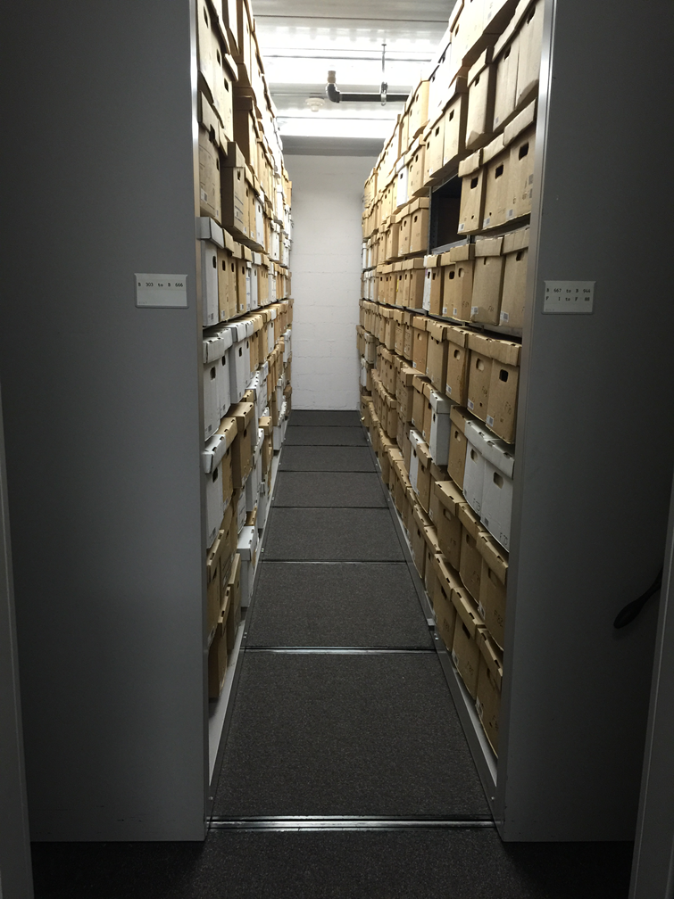
Adventist History
Our history is a source of information, inspiration, pride and education
If records aren’t preserved well, we cannot learn from our past, both what we did right and what we did wrong
Good recordkeeping can keep us transparent, improve our efficiency, and make us more effective

Slide 4
BA 70 15: Vital Records
Specifies that:
1. All organizations and institutions shall give special attention to the permanent preservation and security of their own vital records, such as articles of incorporation, constitutions and bylaws, minutes of boards or governing committees, property records and other legal documents, and also church properties that are of an intellectual nature, such as trademarks and copyrights.

Slide 5
Background
ASTR, commissioned by the Seventh-day Adventist Church to provide coordination, supervision, and quality control to its archives and records centers, serves the thirteen divisions of the world church. Deriving its authority from General Conference Working Policy [BA 70 – Retention and Safeguarding of Records], ASTR management has a solid history of visiting division recordkeeping offices - providing counsel, seminars, and records-management assistance to support division efforts in establishing and maintaining recordkeeping facilities.
In response to division inquiries on ASTR evaluating their efforts to comply with Working Policy BA 70 15: Vital Records, and our desire to take our support to the next highest level, we devised an Accreditation Program.

Slide 6
Goal of the Accreditation Program
Accreditation is a global standard through which a recordkeeping facility of the Seventh-day Adventist Church meets minimum recordkeeping standards and guidelines recommended by the Office of Archives, Statistics and Research (ASTR).
ASTR is committed to improving the quality of recordkeeping institutions operated by the Church worldwide.
ASTR believes that implementing and supporting an effective records accreditation program within these institutions provides an integral tool for quality onsite records management

Slide 8
Why Have An Accreditation Program ?
The task of accreditation is based on the philosophy that each denominational entity, operated in the name of the Seventh-day Adventist Church, assumes the dual responsibility of fulfilling the expectations of its constituency and of supporting the Church’s mission. Accreditation of an institution by ASTR signifies that the institution has a purpose appropriate to service the recordkeeping needs of those in its constituency and has the resources, programs, and services sufficient to accomplish the institution’s goals.
Accreditation plays a significant role in fostering confidence in the recordkeeping of the Church and of its various entities, in serving to maintain minimum standards, enhancing institutional effectiveness, and providing inter-institutional recognition.

Slide 9
Benefits of an Accreditation Program (1 of 3)
1) Accreditation optimizes record content, record quality and record accessibility. The foremost benefit is that your record holdings are now systematically maintained in a manner consistent not just with ASTR’s holdings and recommendations, but in a manner that best facilitates your staff and external records researcher’s accessing those records. Your records are now kept in a systematic manner that best ensures that this records are accessible each and every time they are needed
2) Accreditation improves recordkeeping processes while enhancing the skills and knowledge of your staff. With your records maintained in accordance with ASTR recommendations, all of your records staff members are now trained to perform the same activities every time. This unanimity in performance ensures your department’s record keeping is professionally organized and operated

Slide 10
Benefits of an Accreditation Program (2 of 3)
3) Accreditation reflects achievement and facilitates the best possible way to ensure maintaining the unique history and heritage that those records comprise. Organizing and maintaining your holdings, in a manner consistent with accreditation standards, evidences that you have strived to reach a level of achievement commensurate with only the best recordkeeping centers within the world church. It evidences that you were committed to securing, and achieving, a measure of excellence in recordkeeping
4) Accreditation demonstrates your desire for excellence in the recordkeeping profession. Your attainment of accreditation reflects the fact that you are committed to a recordkeeping performance that is globally recognized by ASTR. It signifies that you want the very best in your recordkeeping and practices, and have done what is necessary to earn that hallmark.

Slide 11
Benefits of an Accreditation Program (3 of 3)
5. Accreditation ensures greater professional recognition from peer facilities while promoting peer efforts to also gain accreditation. Your path to accreditation is part of, and encourages, a cycle towards recordkeeping excellence. As Church recordkeeping facilities around the world become aware of the accreditation process they will recognize the professional achievement, and the work that is needed, in attaining that accreditation. As recordkeeping facilities gain accreditation other recordkeeping facilities will become aware of the process. The more that other recordkeeping facilities become aware of the process and peer recognition of that achievement, the more that other recordkeeping facilities will want to gain accreditation.

Slide 12
Standards
The Office of Archives, Statistics and Research (ASTR) holds to the principle that denominational accreditation is not dependent upon regional, state, or national requirements. Nevertheless, many of the criteria established by ASTR coincide with international archives and records management standards.
The accrediting standards used by the Office of Archives, Statistics and Research comprise the criteria for accreditation. These criteria are subject to periodic evaluation and provide consistent guidelines for the evaluation of archives and records centers.

Slide 13
Levels of Accreditation
ASTR currently recognizes three (3) levels of accreditation:
Recognized – The initial level of recordkeeping accreditation, it reflects implementation of the basic foundations of ASTR’s recommended protocols
for quality recordkeeping. We encourage efforts to subsequently strive
towards the second level of accreditation as appropriate and resources permit.
Approved – The highest level of recordkeeping accreditation, it signifies the
record keeping entity’s desire to maintain and operate records in the best
possible manner.
Center of Excellence – The gold standard for those entity’s privileged to
operate both a records center and an archives. It signifies that they have achieved ASTR’s highest accreditation standard. It is a hallmark of quality recordkeeping reflecting only the most committed and the very best recordkeeping entities.

Slide 14
Eligibility, Application and Survey Processes (1 of 3)
1) All recordkeeping entities operated under the auspices of a World Division of the Seventh-day Adventist Church are eligible, and encouraged, to apply for accreditation.
2) Each World Division will contact all known recordkeeping Church entities within that Division and will apprise the appropriate individuals of accreditation – encouraging them to contact ASTR and/or its website: www.AdventistArchives/Accreditation
3) Both an Introduction to the Accreditation Process narrative and forms for each sought level of accreditation will be available on our site and are downloadable. Further information or questions may be addressed to www.AdventistArchivist.org
4) Each completed application will be processed in a timely manner by ASTR. There are no application costs at present.

Slide 15
Eligibility, Application and Survey Processes (2 of 3)
5) An on-site survey will be conducted by an ASTR and/or GC Secretariat Evaluator or, where situations warrant, Evaluator personnel assigned by the respective Division and approved by ASTR.
6) Prior to visit there will be a request for specific documentation from the entity being surveyed. Upon submission of that documentation and its evaluation from the assigned Evaluator(s), a site visit will be scheduled.
7) Upon completion of the Evaluator’s site visit, copies of all completed survey applications, Evaluator-requested documentation, Evaluator-completed survey forms and Evaluator site visit remarks and recommendations will be forwarded to ASTR’s offices.
8) ASTR will review all submitted documentation and, within ninety (90) days of receipt, will notify the respective recordkeeping entity of whether or not accreditation has been approved.

Slide 16
Eligibility Application and Survey Processes (3 of 3)
9) If accreditation has been approved a Certificate of Accreditation will be issued.
10) If accreditation has not been approved ASTR will apprise the respective recordkeeping entity of deficiency(s) and offer advice as to how best to address them for subsequent re-inspection.
11) All accreditations are valid for a period of five (5) years from the date of issuance.
12) All accredited recordkeeping entities will be notified by ASTR within six (6) months of accreditation expiration to ensure ample time to apply for re-inspection in order to maintain accreditation.

Slide 17
Records Center Accreditation Specifications – Recognized (1 of 3)
Staffing
1) Is there a designated records manager, whether the designee is part-time or full-time?
2) Does the designated records manager have access to someone with training in records management?
Oversight
Is there a committee whose terms of reference include archives and records management?
Policies
1) Are there policies, governing access to materials, for both internal and external researchers?
2) Are there disaster policies and plans in place?
3) Is there a retention schedule in place?

Slide 18
Records Center Accreditation Specifications – Recognized (2 of 3)
Policies (Continued)
4) Are vital records secure (refer to WP BA 70-15) ?
5) Has the retention schedule been updated?
6) Has the retention schedule been applied to records?
7) Are electronic records included in the retention schedule?
Physical Locations and Preservation
1) Is the storage space safe to use?
2) Is the storage space well-lit?
3) Are shelving units stable?
4) Are there ladders or stepladders, commensurate to the shelving, available to allow access to high areas?
5) Does the physical location(s) allow for materials to be preserved?
6) Can access to the storage space be controlled?
7) Is the storage space dry and watertight?

Slide 19
Records Center Accreditation Specifications – Recognized (3 of 3)
Physical Locations and Preservation (Continued)
8) Have measures been taken to prevent and protect against leaks?
9) Have measures been taken to prevent and extinguish fires?
10) Have measures been taken to control termites, mice, and other pests?
11) Is the storage space accessible within an acceptable timeframe (e.g. a week, two weeks)?
12) Is the storage space adequate for current needs?
13) Is there a working relationship between the records center and the institution’s IT department?

Slide 20
Evaluator’s Score Sheet - Records Center – Recognized (1 of 4)
A. Staffing (5 points total)
A1. Is there a designated records manager, whether the designee is part-time or full-time?
Yes ____ = 3 points No ____ = 0 points
A2. Does the designated records manager have access to someone with training in records management?
Yes ____ = 2 points No ____ = 0 points
Section score: _______/5
B. Oversight (5 points total)
B1. Is there a committee whose terms of reference include archives and records management?
Yes ____ = 5 points No ____ = 0 points
Section score: _______/5
C. Physical Locations and Preservation (70 points total)
C1. Is the storage space safe to use? Yes ________ No _________
To get a Yes – Must have 80% of following questions to receive any points from this subsection:
Is the storage space well-lit? Yes ____ (0-5 points) No ____ = 0 points
Are shelving units stable? Yes ____ = 10 points No ____ = 0 points
c. Are there ladders or stepladders, commensurate to the shelving, available to allow access to high areas? (0-5 points)
C1 subsection score: _______/20

Slide 21
Evaluator’s Score Sheet – Records Center – Recognized (2 of 4)
C2. Does the physical location(s) allow for materials to be preserved? Yes ______No _________
To get a Yes – Must have 80% of following questions to receive any points from this subsection:
a. Can access to the storage space be controlled? Yes ____ = 10 points No ____ = 0 points
b. Is the storage space dry and watertight? Yes ____ = 10 points No ____ = 0 points
c. Have measures been taken to prevent and protect against leaks? (0-5 points)
d. Have measures been taken to prevent and extinguish fires? Yes ____ = 5 points No ___ = 0 points
e. Have measures been taken to control termites, mice, and other pests? (0-5 points)
C2 subsection score: _______/35
C3. Is the storage space accessible within an acceptable timeframe (e.g. a week, two weeks)? (0-5 points)
C4. Is the storage space adequate for current needs? (0-5 points)
C5. Is there a working relationship between the records center and the institution’s department? (0-5 points)
Section score: _______/70

Slide 22
Evaluator’s Score Sheet – Records Center – Recognized (3 of 4)
D. Policies (35 points total)
D1. Are there policies, governing access to materials, for both internal and external researchers?
Yes ____ = 5 points No ____ = 0 points
D2. Are there disaster policies and plans in place? Yes ____ = 5 points No ____ = 0 points
D3. Is there a retention schedule in place? Yes ____ = 5 points No ____ = 0 points
D4. Are vital records secure (refer to WP BA 70-15) ? Yes ____ = 5 points No = 0 points
D5. Has the retention schedule been updated in the last 5 years? (0-5 points)
D6. Has the retention schedule been applied to records? (0-5 points)
D7. Are electronic records included in the retention schedule? (0-5 points)
Section score: _______/35

Slide 23
Evaluator’s Score Sheet – Records Center – Recognized (4 of 4)
A section score: _____/5
B section score: _____/5
C section score: _____/70
D section score: _____/35
Total score: _______/115
Things for Evaluators to Remember:
1) Applicant must achieve an overall minimum of 50% in order to achieve recognized status
2) If A1 has a score of zero points, applicant is not eligible to achieve recognized status until records manager has been designated.
3) If B1 has a score of zero points, applicant is not eligible to achieve recognized status until oversight committee, whose terms of reference include archives and records management, is created.
4) If either C1 or C2 have a score of less than 80%, applicant is not eligible to achieve recognized status until issues are corrected.
5) If D3 has a score of zero points, applicant is not eligible to achieve recognized status until retention schedule is created and implemented.
6) If Section D has an overall section score of less than 60%, applicant is not eligible to achieve recognized status until those policies are created.
Recommendation for status: ­­­­­­­­­­____________________________________

Slide 24
Archives Accreditation Specifications – Recognized (1 of 3)
Staffing
1) Is there a designated archivist, whether the designee is part-time or full-time?
2) Does the designated archivist have access to anyone trained in dealing with archival material?
Oversight
1) Is there a committee whose terms of reference include archives and records management?
Physical Locations and Preservation
1) Is the storage space safe to use?
2) Is the storage space well-lit?
3) Are shelving units stable?
4) Are there ladders or stepladders, commensurate with shelving, available to allow access to high areas?

Slide 25
Archives Accreditation Specifications – Recognized (2 of 3)
5) Does the physical location(s) allow for materials to be preserved?
6) Can access to the storage space be controlled?
7) Is the storage space dry and watertight?
8) Have measures been taken to prevent and protect against leaks?
9) Have measures been taken to prevent and extinguish fires?
10) Have measures been taken to control termites, mice, and other pests?
11) Is the storage space accessible within an acceptable timeframe (e.g. a week, two weeks)?
12) Is the storage space adequate for current needs?
13) What is the relationship between the archives and the institution’s IT department?

Slide 26
Archives Accreditation Specifications – Recognized (3 of 3)
Policies
1) Are there policies governing access to material for researchers?
2) Are there policies related to external researchers?
3) Is there a researcher’s agreement?
4) Is there a researcher’s code of conduct?
5) Are vital records secure (refer to WP BA 70-15) ?
6) Are there policies dealing with restrictions of material?
7) Is there a collection management policy?
8) Are there disaster policies and plans?
9) Does any policy deal with electronic records? If yes, which ones?
10) Is there an established policy for creating Memoranda of Understanding with donors?
11) Does your policy address what can trigger the return of an item?
12) Does your policy address the conditions of preservation for an item?
13) Does your policy address potential restrictions on access to an item?

Slide 27
Archives Accreditation Specifications Score Sheet – Recognized – (1 of 5)
A. Staffing (5 points total)
A1. Is there a designated archivist, whether the designee is part-time or full-time?
Yes ____ = 3 points No ____ = 0 points
A2. Does the designated archivist have access to anyone trained in dealing with archival material?
Yes ____ = 2 points No ____ = 0 points
Section score: _______/5
B. Oversight (5 points total)
B1. Is there a committee whose terms of reference include archives and records management?
Yes ____ = 5 points No ____ = 0 points
Section score: _______/5
C. Physical Locations and Preservation (70 points total)
C1. Is the storage space safe to use? Yes ________ No _________
To get a Yes – Must have 80% of following questions to receive any points from this subsection:
a. Is the storage space well-lit? (0-5 points)
b. Are shelving units stable? Yes ____ = 10 points No ____ = 0 points
c. Are there ladders or stepladders, commensurate to the shelving, available to allow access to high areas? (0-5 points)
C1subsection score: _______/20

Slide 28
Archives Accreditation Specifications Score Sheet – Recognized – (2 of 5)
2. Does the physical location(s) allow for materials to be preserved? Yes ________ No _________
To get a Yes – Must have 80% of following questions to receive any points from this subsection:
2a. Can access to the storage space be controlled? Yes ____ = 10 points No ____ = 0 points
2b. Is the storage space dry and watertight? Yes ____ = 10 points No ____ = 0 points
2c. Have measures been taken to prevent and protect against leaks? (0-5 points)
2d. Have measures been taken to prevent and extinguish fires?
Yes ____ = 5 points No ____ = 0 points
2e. Have measures been taken to control termites, mice, and other pests? (0-5 points)
C2 subsection score: _______/35
3. Is the storage space accessible within an acceptable timeframe (e.g. a week, two weeks)? (0-5 points)
4. Is the storage space adequate for current needs? (0-5 points)
5. Is there a working relationship between the records center and the institutional IT department? (0-5 points)
Section score: _______/70

Slide 29
Archives Accreditation Specifications Score Sheet – Recognized – (3 of 5)
D. Policies (43 points total)
Are there policies governing access to materials for researchers? Yes ____ No ____
To get a Yes – Must have 60% of following questions to receive any points in this subsection:
a. Are there policies related to external researchers? (0-2 points)
b. Is there a researcher’s agreement? (0-2 points)
c. Is there a researcher’s code of conduct? (0-2 points)
D1 subsection score: _______/6
2. Are vital records secure (refer to WP BA 70-15) ? Yes ____ = 5 points No = 0 points
3. Are there policies dealing with restrictions of material? Yes ____ = 5 points No ____ = 0 points
4. Is there a collection management policy? Yes ____ = 5 points No ____ = 0 points

Slide 30
Archives Accreditation Specifications Score Sheet – Recognized – (4 of 5)
5. Are there disaster policies and plans? Yes ____ = 5 points No ____ = 0 points
6. Does any archival policy deal with electronic records? If yes, which ones?
Yes ____ = 5 points No ____ = 0 points
7. Is there an established policy for creating Memoranda of Understanding with donors? Yes _____ No ______
To get a Yes – Must have 60% of following questions to receive any points in this subsection:
7a. Does the policy address what can trigger the return of an item? (0-3 points)
7b. Does the policy address the conditions of preservation for an item? (0-3 points)
7c. Does the policy address potential restrictions on access to an item? (0-3 points)
D7 subsection score: _______/9
Section score: _______/43

Slide 31
Archives Accreditation Specifications Score Sheet – Recognized – (5 of 5)
A section score: _____/5
B section score: _____/5
C section score: _____/70
D section score: _____/43
Total score: _______/120
Things for Evaluators to Remember
1) Applicant must achieve an overall minimum of 50% in order to achieve recognized status.
2) If A1 has a score of zero points applicant is not eligible to achieve recognized status until archivist has been designated.
3) If B1 has a score of zero points applicant is not eligible to achieve recognized status until oversight committee, whose terms of reference include archives and records management, is created.
4) If either C1 or C2 have a score of less than 80%, applicant is not eligible to achieve recognized status until issues are corrected.
5) If either D1 or D6 have a score of less than 60%, applicant is not eligible to achieve recognized status until those policies are created.
6) If Section D has an overall section score of less than 60%, applicant is not eligible to achieve recognized status until those policies are created.
Recommendation for status: ­­­­­­­­­­____________________________________

