Slide 1
Managing Digital Photos and Media Assets: Potential Software Solutions
Presented By Kenrie Hylton
Association of Seventh-Day Adventist Librarians Conference
Newbold College, 2017
Notes:
Due the ever-increasing number of digital photos and other like media being generated, there is a growing need to appropriately store, organize and manage these digital assets. This presentation explores this subject and offers general guidelines and best practices regarding digital asset management. Potential software solutions will be reviewed as well as compared towards identifying their merits and shortcomings.

Slide 2
TYPES OF DIGITAL MEDIA ASSETS
Digital Photos
Audio
Video
Notes:
Digital assets are digital content files, such as photographic images, audio, video, graphics, text files, or data. They may be stored locally on a server, digital device (PC, tablet, media player, etc.), or in the cloud.
Digital asset management, or DAM, is the process by which a person or organization categorizes, stores, and shares its digital assets. A DAM system is a software solution that facilitates and automates the DAM process.

Slide 3
Media Asset organization process
Audit
Review non digitized holdings to determine what you have
Selection
Determine what to do with what you have
What should be digitized, what should be stored or tossed
Digitization
Digitize the media holdings that have been so designated
Storage
Aptly store items in a determined physical location
Create a digital storage area and store digitized content in this allocated space
Establish metadata standards, and enter metadata
Notes:
Content yet to be digitized
Audit can be long and difficult, but the benefits are significant
May choose to itemize each asset, which would be great – but keeping things simple and grouping by collections may be best

Slide 4
Media asset Organization process
DIGITIZE
SCAN
AUDIT
PROCESSING
DIGITAL STORAGE
STORE
TOSS
PHYSICAL STORAGE
TRASH
Notes:
My focus for the rest of the presentation will be on what comes next

Slide 5
STEPS TO IMPLEMENTING A DIGITAL ASSET MANAGEMENT SYSTEM
Audit Existing Digital Collection
Determine Needs
Review & Select Software
Implementation
Notes:
Conduct a content audit of all digital assets

Slide 6
AUDIT EXISTING COLLECTION
Conduct a thorough content audit of digital assets
How many files do you have?
How much digital storage space do they use?
What types of files do you have?
Where are the files stored?
Who needs access?
Notes:
Before you can look for a solution, you need to have an understanding of the problem or the extent of the challenge you intend to address
Easier than audit of physical files

Slide 7
AUDIT EXISTING COLLECTION
Media Type | File Type | Number of Files | Total File Size
Photo | TIFF | 1000 | 200 GB
Photo | JPG | 1400 | 20 GB
Photo | PNG | 800 | 30 GB
Video | MKV | 27 | 270 GB
Audio | MP3 | 85 | 300 MB
Location
P:\Photos C:\Documents\Pictures D:\Photo Collection C:\Documents\Ellen White Photos C:\Backup\Adventist_Images D:\Sermons
User | Collection | Access Type
James White | All | Full Access
Benjamin Franklin | Ellen White Collection Adventist Buildings | Read Only Read Only
Rebekah Moore | Audio Collection | Full Access
Notes:
Before you can look for a solution, you need to have an understanding of the problem or the extent of the challenge you intend to address
Easier than audit of physical files

Slide 8
DETERMINE NEEDS
Estimate Digital Storage Space Needs
Prepare a list of Requirements for Software
What functions are essential?
What additional features would be desired?

Slide 9
How much digital storage space will you need?
DETERMINE NEEDS
How much digital storage is currently being used?
How much more will be needed for future additions?

Slide 10
Photo File Size Estimates
300 DPI PRINT SCANS:
 | Pixel Dimensions | JPEG File Size | TIFF File Size
3 X 5 | 900 x 1500 | 650 KB - 1 MB | 3.9 MB
4 X 6 | 1200 x 1800 | 1.1 MB - 1.6 MB | 6.3 MB
5 X 7 | 1500 x 2100 | 1.6 MB - 2.3 MB | 9.2 MB
8 X 10 | 2400 x 3000 | 3.2 - 4.5 MB | 21.2 MB
Approximately 85GB for every 1,000 photos (600dpi 8 x 10)
600 DPI PRINT SCANS:
 | Pixel Dimensions | JPEG File Size | TIFF File Size
3 X 5 | 1800 x 3000 | 2.4 MB - 3.5 MB | 15.8 MB
4 X 6 | 2400 x 3600 | 3.6 MB - 5.2 MB | 25.3 MB
5 X 7 | 3000 x 4200 | 4.8 MB - 6.9 MB | 36.9 MB
8 X 10 | 4800 x 6000 | 9.1 MB - 14.3 MB | 84.4 MB
Video varies by format and compression (2GB – 1TB per hour of video)

Slide 11
Requirements
Must Haves
Would Like
Metadata Management
Embed Metadata Within Photos
Facilitates Multiple Users over Network
Filtered Search
Batch Editing of Properties
Batch Rename
Manage Audio/Video Files
Security/Permissions
Broad File Format Support
Categorization
Watermarking
Image Editing Tools
Multiple Catalogs
Keyword Search
Social Media Sharing
Website Gallery Publishing

Slide 12
REVIEW & SELECT SOFTWARE
Considerations When Selecting a Digital Asset Management System
Methods of Inputting Metadata
Ability to Scale (Assets and Users)
Customizable
Grouping & Cataloging Options
Interoperability with Other Systems
Audio/Video Management Capabilities
Notes:
Evaluate Metadata Input Methods. User adoption of a DAM system depends on metadata entry.
Ability to Scale.
Consider the Degree of System Customization. Flexible enough to meet the needs of your users. Understand how simple or complex it will be to configure the DAM (custom code or toggle settings)
Determine Cataloging Capabilities. should be able to present assets in catalogs that are curated for specific users.
Make Sure it Can Integrate with Other Systems

Slide 13
Considerations When Selecting a Digital Asset Management System
REVIEW & SELECT SOFTWARE
Search Functionality
Assets only useful if you can find them
Explore search filters and advanced searching features
Security & Permissions
Developer Track Record
Customer Support
Notes:
Evaluate Asset Search Sophistication.
The assets in a digital asset management system are only useful if you can find them.
Strong DAM systems have many search filters and advanced ones are bringing in new and sophisticated search techniques and technologies.
Scope Out Permissions. Making assets only available to those who need them. Permissions should be available at catalog, group and even individual asset levels.
Verify Security Features. Keep your assets safe Investigate Vendor Track Record. Go with a trusted vendor with an established DAM platform
Assess Customer Support. Vendor who will support your system with true customer care and dedicated support staff. DAM is an ongoing program, not just an installation.

Slide 14
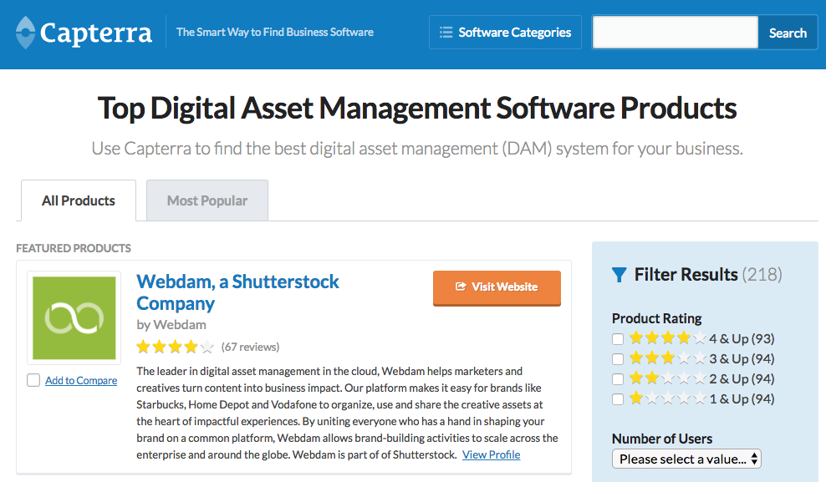
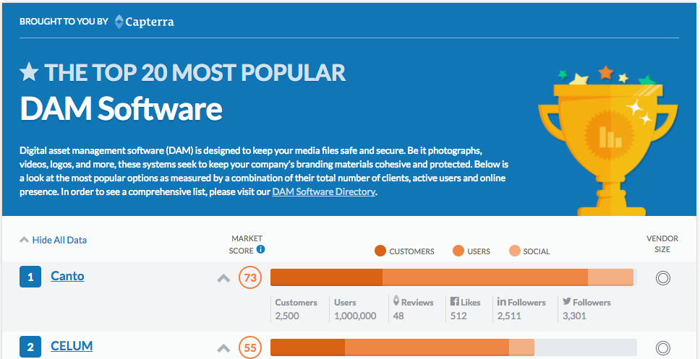
Software Review Website
www.capterra.com

Slide 15
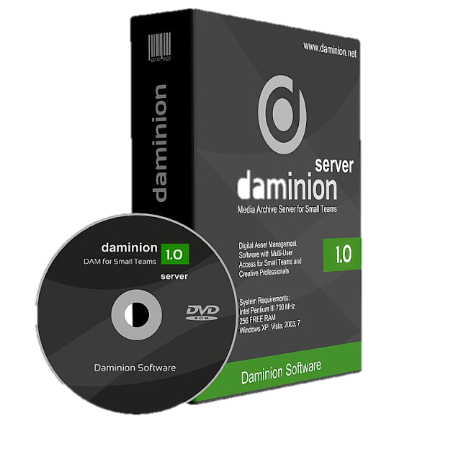
Phase One Media Pro SE
Daminion Digital Asset Management System
Adobe Bridge CC

Slide 16
Comparison Table
Software | Phase One Media Pro SE | Daminion | Adobe Bridge
Metadata Management | ✅ | ✅ | ✅
Embed Metadata Within Photos | ✅ | ✅ | ✅
Facilitates Multiple Users over Network | ✅ | ✅ | ✅
Filtered Search | ✅ | ✅ | ✅
Batch Editing of Properties | ✅ | ✅ | ✅
Batch Rename | ✅ | ✅ | ✅
Manage Audio/Video Files | ✅ | ✅ | ✅
Security/Permissions | ⛔ | ✅ | ⛔
Broad File Format Support | ✅ | ✅ | ✅
Required Features
Notes:
Common Features
Assign Metadata to a Batch of photos
Embed metadata into photos
Ratings
Watch/Auto Import Folder
Manage A/V Files

Slide 17
Comparison Table
Software | Phase One Media Pro SE | Daminion | Adobe Bridge
Categorization | ✅ | ✅ | ✅
Watermarking | ✅ | ✅ | ⛔
Image Editing Tools | ✅ | ⛔ | ⛔
Multiple Catalogs/Photo Collections | ✅ | ✅ | ✅
Keyword Search | ✅ | ✅ | ✅
Social Media Sharing | ⛔ | ⛔ | ⛔
Website Gallery Publishing | ✅ | ✅ | ⛔
Additional Desired Features
Notes:
Common Features
Assign Metadata to a Batch of photos
Embed metadata into photos
Ratings
Watch/Auto Import Folder
Manage A/V Files

Slide 18
Adobe Bridge
Pros & Additional Features
Provides extensive metadata fields that extend beyond photos and includes general media management. Allows users to create Metadata Templates Very Robust and Flexible “Batch Rename” functionality Create and Save Custom Workspaces (User Interfaces) Free (for now)
Cons
Does NOT facilitate user permissions and access restrictions Collections are local only and not accessible by other users over a network

Slide 19
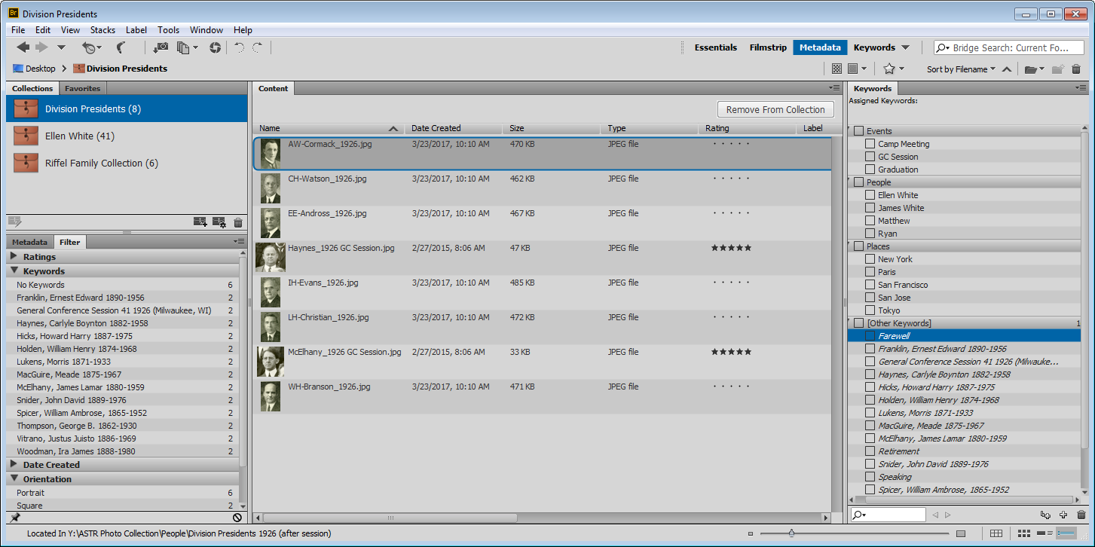
Adobe Bridge

Slide 20
Daminion Digital asset management system
Pros & Additional Features
Facilitates embedding Watermarks on a batch of images. Feature that finds all duplicate images regardless of filename. Facilitates Checking In & Out images for editing. (Essentially prevents 2 persons from editing at the same time). Allows Tags and Image properties to be copied from one to others. Easy to filter assets by file type Extremely easy to use and flexible filtered search. Searches can be saved to allow users to easily conduct the search again Web-Client allows access to the catalog via the Internet Can publicly share select collections via the web Supports a significant number of video file types Supports Windows Authentication for User Access
Cons
Multi-user license can be expensive Limited ”Batch Rename” functionality

Slide 21
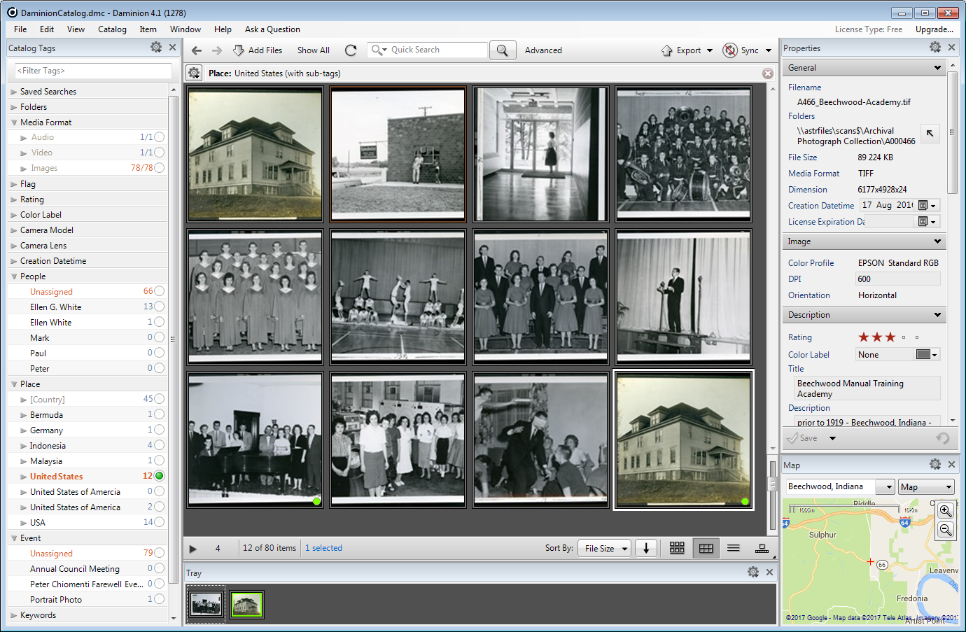
Daminion asset management system
Notes:
Map interface, view photos on the map

Slide 22
Phase One Media Pro SE
Pros & Additional Features
Web Gallery Export feature allows users to easily export catalogs to a format that can be uploaded to a website. Allows custom metadata fields to be added, however these are not stored in the image files themselves, but instead kept in a local database. Basic image editing functions included if necessary. Duplicate photos finder. Image Conversion Tools Convert Image Files to JPG, PNG, BMP, Photoshop, etc. Audio and Video File conversion functionality as well Easy Backup to CD/DVD PDF Creator Slide Show and Save Slide Show as Movie
Cons
Does NOT offer advanced search functions Does NOT facilitate user permissions and access restrictions

Slide 23
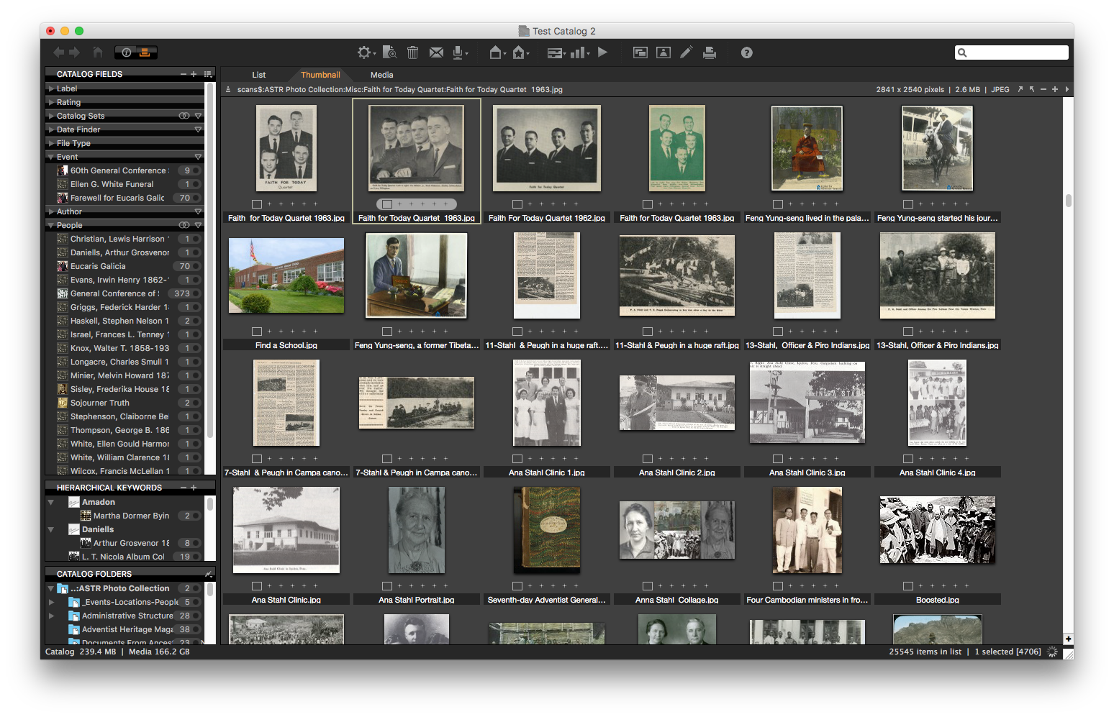
Phase One Media Pro SE

Slide 24
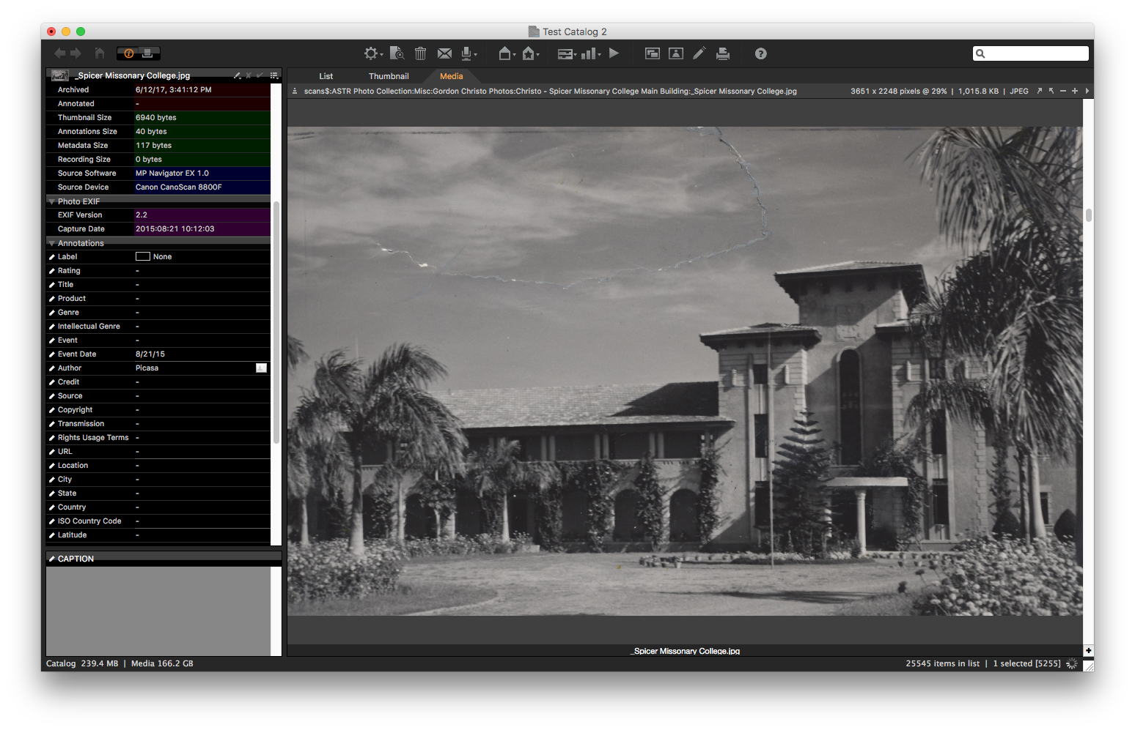
Phase One Media Pro SE

Slide 25
IMPLEMENTATION
Digital Asset Manager Role for the Implementation/Roll Out
Phased Implementation (Roll out to new groups in phases)
Train Users
Notes:
During the initial stages of the implementation and rollout, someone should “own” the system and become the point of contact for issues and plan training for users to ensure that assets are being ingested and tagged properly. This role is critically important to the implementation and ongoing success of the project.
An agile approach to implementation means smoother rollout and the ability to test feature based on the valuable feedback provided by users during the process. DAM implementations are complex and include integrations with internal systems, data models, product master data sets, naming conventions, and existing processes. A phased implementation allows you to mitigate project risks.
If you are considering a system for ten or more groups within your organization, identify the three or four departments that include quick adopters and have a mix of simple and complex requirements. This will allow you to establish some quick wins and then expand the deployment to the other departments using the first phase to assist in the follow-on training.

Slide 26
QUESTIONS

