Slide 1
Submitting Data for the Annual Statistical Report
A presentation by Kathleen Jones, ASR Editor

Slide 2
Churches and Membership

Slide 3
Page 1
Annual Report Page 1 (membership statistics) will be generated from the four quarterly reports submitted through MyReport.

Slide 4
Denominational Employees

Slide 5
Important Things to Remember
Accuracy is essential. Other reports and comparisons, as well as analyses and research, will be based on these figures. Neatness and clarity are essential. Proof your work!
See that all figures are properly punctuated—separate the millions, thousands, and hundreds with commas.
The purpose of this report is to record a brief but comprehensive picture of the church's status in each field. Denominational employee data must account for every full time, part time, and casual employee, as well as literature evangelists who are all self employed. (Do not include other contract workers.) Casual employees are those who are working for the denomination as temporary or “contingent” employees with pay.

Slide 6
Pages 2 & 3
NOTE: Beginning in 2015 you have seen new sub-columns for nearly every column that has been previously part of these reports . This is because some divisions have begun to issue credentials to part time employees. As of the 2015 Annual Council, this practice is NOW ACCEPTED BY POLICY. We have added columns so that part time credentialed employees may be correctly counted.

Slide 7
Pages 2 & 3
All full time credentialed employees should be listed in the "FT" (full time) employee sub-columns.
Record part time credentialed employees in the "PT" (part time) sub-columns.
Casual employees should be listed in the “C” sub-column and may not be issued credentials.
NOTE: An employee must work at least 15 hours per week in order to qualify as part time.

Slide 8
Page 2
22a-24. Credentialed Employees. Ministerial credential, commissioned minister credential, commissioned ministry of teaching credential, administrative ministries credential, and missionary credential granted by the local conference or mission, whether in conference or institutional work, are to be reported in their respective columns. Bible instructor credentials are to be reported as commissioned ministers, except in divisions where commissioned minister credential is not used, then give them a missionary credential.
Remember: no person shall be included in more than one category at the same time. Missionary Credentials and Missionary Licenses are to be issued to non-ministerial employees.
(The number of the instruction corresponds with the number of the column on the report form.)

Slide 9
Page 2
25a-27. Licensed Employees. Employees to whom a conference or mission has granted licenses should be reported in their respective columns, whether employed by conferences or institutions. Bible instructor licenses are to be reported as commissioned ministers licenses, except in divisions where the commissioned minister license is not used, then give them a missionary license.

Slide 10
Page 2
29. All Other Employees. Include here all conference and mission employees to whom credentials or licenses have not been issued, such as office assistants, helpers, academy or church school teachers, etc. who are working full time, part time or as casual employees and receiving denominational pay. This also includes Ministry of Teaching licenses, since they do not appear anywhere else on this table. Do not include lay preachers or others not on denominational payrolls.
NOTE: Separate these employees into the full time (FT), part time (PT), and casual sub-columns. For this category ALL divisions should have employees in each of these sub-columns.

Slide 11
Page 2
31. Honorary/Emeritus Credential Only. Retirement beneficiaries and others receiving honorary/emeritus credentials will be reported by the unions granting such papers. On the union line, report all such employees in one figure for each union. (Exception: attached fields may list them out.) Only report those who were given an honorary credential!

Slide 12
Page 2
Total for 28a, 28b, and 28c (calculated by formula):
28a. Literature Evangelists: Credentialed and Licensed. Only regular book and periodical literature evangelists who hold literature evangelist credentials or licenses are to be reported in this column.
28b. Literature Evangelists: Interns or Other Full Time. All other regular full time LE's who are not yet credentialed or licensed.
28c. Literature Evangelists: Part time. Those literature evangelists who are working part time (not to include summer students.)

Slide 13
Page 2
32-34. Active Employees columns. In these three columns record the number of regular full time, part time, and casual employees from the columns 22a through 27, and column 29. Do not include the Literature Evangelists columns 28a-28c.
30. Total Active Employees. This figure is the total of columns 22a-29 (except Column 28!). The vertical total for this column is to be checked against the horizontal grand total of all totals in columns 22a-29 (except Column 28!). These two figures are to be the same.

Slide 14
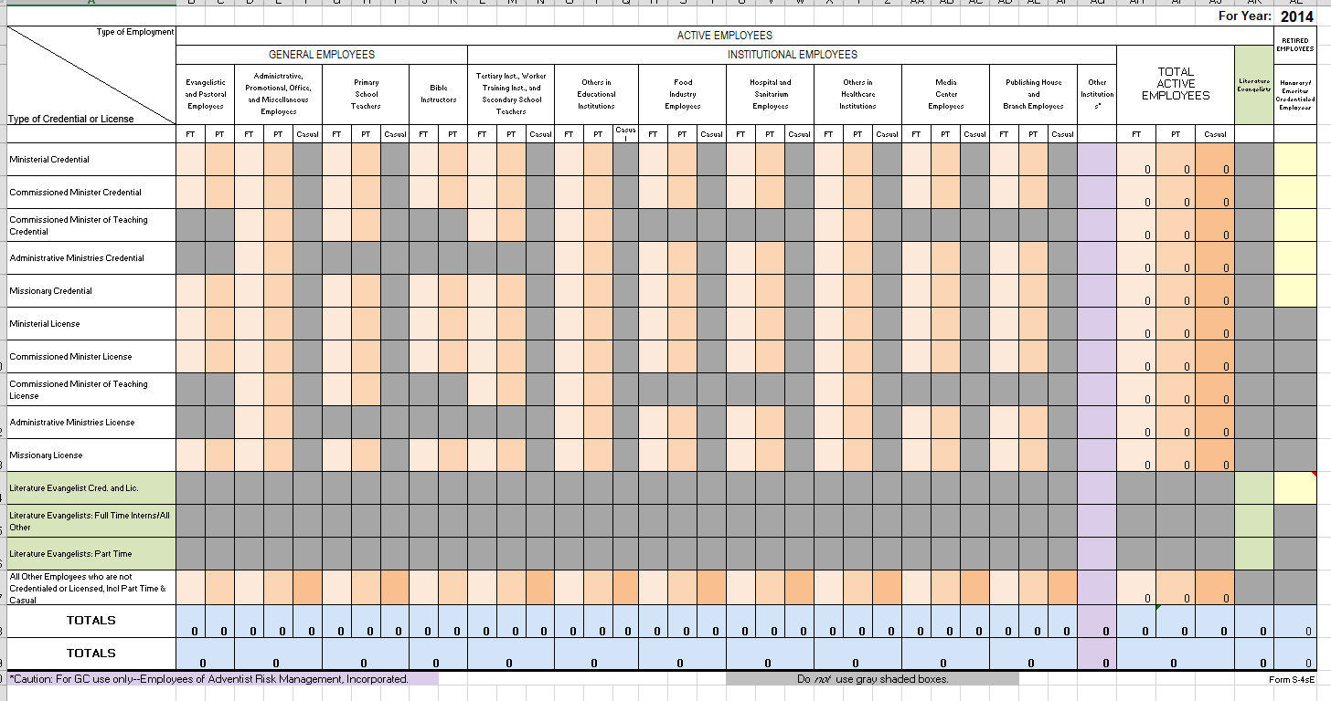
Page 3
General Employees
Institutional Employees
The columns provide space for denominationally employed workers by type of employment.
The rows provide space for all credentials and licenses.
Each employee is to be accounted for by row AND by column.

Slide 15
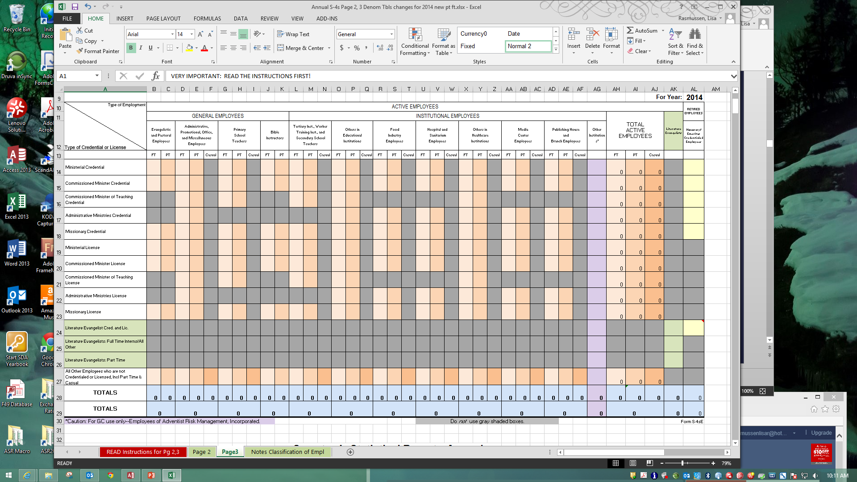
Page 3
List all honorary/emeritus (retired) employees in the last column. Credentialed only—do not list any who are licensed!
Example. A full time licensed missionary who works in an educational institution but is not a teacher would be tabulated in the box where the Missionary License row and the Others in Educational Institutions column intersect. (Primary Schools are not educational institutions.)

Slide 16
Page 3
NOTE: Some combinations of credential and type of employment are not valid. The squares for these combinations are grayed out and no data should be placed there. For example, an Administrative Ministries Credential or License is only issued to someone who is NOT in direct evangelistic and pastoral work.

Slide 17
Page 3
Also, of those holding Ministerial Credentials, only the ones who are employed as pastors/ associate pastors of a congregation or who are employed by a conference/union specifically as an evangelist should be listed as an evangelistic and pastoral employee. An individual with a Ministerial Credential who holds an elected position at the conference level or above should be listed as doing administrative work.

Slide 18
Page 3
The row totals of each credential and license category must equal the column totals of columns 22a to 29 on page 2.

Slide 19
Page 3
The total of the column "Total Active Employees" must equal the total of column 30 on page 2.
The total of the column "Honorary/Emeritus Credentialed Employees" must equal the total of column 31 on page 2.

Slide 20
Page 3: Classification of Employees
Ministerial Credential—ordained ministers of the gospel
Ministerial License—not ordained, ministerial employees who have demonstrated a divine call to ministry who will eventually be ordained
Commissioned Minister Credential—associates in pastoral care with five or more years of experience. (i.e. Bible instructors; GC, division, union, local conference/mission treasurers and departmental directors including associate and assistant directors; institutional chaplains; presidents and vice presidents of major institutions; auditors)
Commissioned Minister License—associates in pastoral care, less than five years of service

Slide 21
Page 3: Classification of Employees
Commissioned Ministry of Teaching Credential—a school teacher with six or more years of service
Commissioned Ministry of Teaching License—with three or more years of experience
Administrative Ministries Credential—non-ministerial employee in a leadership position with 5 or more years in denominational employment (must be salaried and a union, conference, or institutional officer, administrator, director, or associate director)
Administrative Ministries License—non-ministerial employee in a leadership position with less than 5 years in denominational employment (must be salaried and a union, conference, or institutional officer, administrator, director, or associate director)

Slide 22
Page 3: Classification of Employees
Missionary Credential—five or more years of service (this includes regularly employed institutional and office employees)
Missionary License—less than five years of service
Literature Evangelist Credential—permanent, regular self-employed literature evangelist (who sells products furnished by official SDA publishing houses) who have completed 12 months of work and have met other requirements
Literature Evangelist License—full time beginners who have worked at least three months and have reached the other requirements
Literature Evangelist Intern—a new recruit who holds an identification card

Slide 23
Page 3: Classification of Employees
All Other Regular Employees—are full time, part time, or casual workers who receive denominational pay and have not been issued credentials or licenses
Ministry of Teaching License—entry level teachers. Report in "All Other Regular Employees" column/row.
Full-Time Denominational Employee—must be on the payroll of an SDA institution/primary school and receive service credit for their work

Slide 24
Page 3: Classification of Employees
Colleges—report employees on the union line
Academies and lower—report employees on the conference line
Adventist Book Center Employees—Report under the "Administrative, Promotional, Office & Misc Employees" column. Exception: for ABC's run by Publishing Houses, report their employees as "Publishing House and Branch Employees."
Adventist World Radio Employees—classified as "General Employees," not institutional employees
Healthcare Employees—healthcare institutions owned and operated by a conference count as conference employees. Healthcare institutions owned and operated by a corporation count as employees of the union where they are located.

Slide 25
Activity A:
Life-Size Page 3
On-screen Page 3
On-screen Page 2

Slide 26
Page 5
Column 1. Division, Union, and Country. This column will be filled in when you receive the form. The countries in this list should correspond with the countries in MyReport. If any unions change during fourth quarter and the change is not reflected on this form, please update.
Column 2. Ministerial Credential (Ordained Ministers). The purpose of reporting ordained ministers in this table is to show how many are working on the “front lines” as full time pastors (or evangelists). Enter the number of ordained ministers working in each country. Do not include those who appear on the division and union lines on Page 2 (those who serve in administrative positions at the division and union levels; nor any who work in local field offices). The total Ordained Ministers reported on page 5 for your division should be the same as reported on Page 3, on the Ministerial Credentials row, in the first cell for Evangelistic and Pastoral Employees column.

Slide 27
Page 5
The union totals on this form must agree with the matching union's report—the first cell on Page 3, on the Ministerial Credential row.
Counts by country must add up to their union’s total.

Slide 28
Activity B: Page 5
Division, Union, and Country | Ordained Ministers
Edible Union Conference
Fruitistan
Grainairy | 12
Legumie | 4
Nutso | 31
Protienne | 17
Vegetablia

Slide 29
Reporting Deadline:
Pages 2, 3, and 5 must be submitted by March 31.

Slide 30
Missionaries

Slide 31
Missionary Table
This table contains information which must be supplied by the division. Send us only the division totals--do not break down the numbers by union or local fields on the form you send to us.

Slide 32
Missionary Table
New Missionary Arrivals: For each of the categories on the spreadsheet, count the number of individuals who:
are not IDEs (interdivision employees)
are working in your territory but not in their country of citizenship
began work within the calendar year, for periods exceeding two months

Slide 33
Missionary Table
Missionaries Currently Serving: For each of the categories on the spreadsheet, count the number of individuals who:
are not IDEs (interdivision employees)
are working in your territory but not in their country of citizenship for two months or more

Slide 34
Missionary Table
For each section on the form (“New Missionary Arrivals” and “Missionaries Currently Serving”), an individual must meet ALL of the criteria in order to be counted.
“Missionaries Currently Serving” will include all of the individuals counted as “New Missionaries” of the current year plus those who are currently serving in the mission field. This count is to be a total of all who are “new” and are “currently serving,” for the entire year, not just those who exist at end of year.

Slide 35
Reporting Deadline:
Missionaries Table must be submitted by March 31.

Slide 36
Activity C:
On-screen Missionaries Table

Slide 37
Broadcast Ministries

Slide 38
Broadcast Ministries Table
Radio Section
TV Section
Production Section
Note: Columns New in 2014

Slide 39
Broadcast Ministries Table
This report contains separate tabs for compiling the information from each individual radio station, TV station, and media center.
The totals from each of these tabs should be carried over onto the main Report Form.
Sample forms are also included.

Slide 40
Reporting Deadline:
Broadcast Ministries report must be submitted by June 15.

Slide 41
Countries or Areas of the World Where SDA Work Is or Is Not Established

Slide 42
Where Work is or is not Established
Established work exists in a country or area of the world when one or more of the following criteria have been met:
(1) when an organized church meets regularly;
(2) when a mission station, healthcare facility, or school is functioning regularly; or
(3) when a regular full-time denominational employee is based in the country carrying on outreach or soul-winning activities through such units as a Sabbath school, an organized company, or a language school.
Seventh-day Adventist work is not considered to be established in a country or area when it is limited to a series of evangelistic meetings, literature-evangelist work not based there, scattered Sabbath keepers, employees traveling through, or temporary service by regular employees, student missionaries, or other volunteer employees.

Slide 43
Where Work is or is not Established
Review all countries on the list, making modifications as necessary.
If SDA work is established in a country, indicate with a "YES".
If SDA work is NOT established in a country, indicate with a "NO“
For any value that is changed, please change the fill color, to indicate a change. Use:

Slide 44
Reporting Deadline:
Countries/Areas Where SDA Work is or is not Established report must be submitted by June 15.

Slide 45
Languages and Dialects Used for SDA Work

Slide 46
Languages Used for SDA Work Published and/or Oral
If Seventh-day Adventist publications are printed in a language, enter "YES" in the IsPublished column. The SDA Languages in print list should include all internal SDA publications as well as external SDA publications.
If Seventh-day Adventist work is being conducted using a language, but no materials are printed, enter "ORAL ONLY" in the IsPublished column.

Slide 47
Languages, Published and/or Oral Used for SDA Work
An Asterisk (*) beside a language name means the language is not listed in the 2015 edition of the “Ethnologue,” a list of world languages (http://www.sil.org/), or may not be spelled the same as in the Ethnologue.

Slide 48
Languages, Published and/or Oral Used for SDA Work
ISO Language Codes for languages can be found on the www.ethnologue.com website. They are based on the ISO 639-3 standard. (If the ISO Language Code column contains a number, Archives and Statistics personnel were not able to identify that language in the Ethnologue.)

Slide 49
Languages, Published and/or Oral
If a new language needs to be added to the list, enter the appropriate information for each column, and highlight the row.
If a language in this list is no longer used orally and is no longer used for publications, type "NO LONGER USED" in the IsPublished column, and highlight. Do not highlight any information that is not being revised.
For any information that is changed, please change the fill color, to indicate a change. Use:

Slide 50
Reporting Deadline:
Languages report must be submitted by June 15.

Slide 51
Departmental Reports

Slide 52
The following departments submit reports through their union/division counterparts:
ADRA
Children’s Ministries
Education
Healthcare
Publishing
Sabbath School and Personal Ministries
Women’s Ministries
Youth Ministries

Slide 53
Reporting Deadline:
Departmental reports must be submitted by April 30.
ADRA’s report must be submitted by
June 15.

Slide 54
Thanks for contributing!

